Slide 2
Honor Your Commitments
Deuteronomy 23:21-23
Proverbs 20:25
Ecclesiastes 5:5

Slide 3
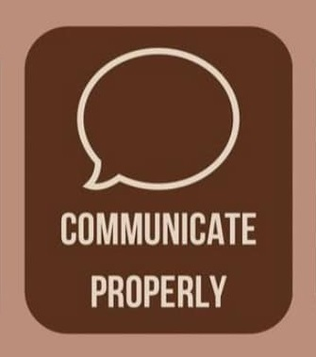
Communicate Properly
1st Corinthians 14:7-9
Matthew 5:37

Slide 4
Make Careful Decisions
Luke 14:25-32
Proverbs 11:15

Slide 5
Be Consistent In Your Actions
Proverbs 24:21
Ephesians 4:14
Romans 2:21

Slide 6
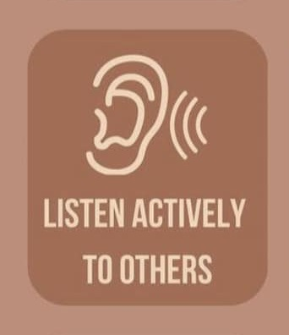
Listen Actively to Others
Proverbs 18:13, 17; John 7:51
Mark 4:23; Romans 10:17

Slide 7
Help Others
Deuteronomy 22:1-4
Luke 10:25-37
Matthew 6:1-4

Slide 8
Share Your Feelings Openly
Proverbs 29:11; 14:33
Judges 16:17
Luke 2:19, 51

Slide 9
Admit Mistakes
James 5:16
Psalm 147:6

Slide 10
Apologize When You Are Wrong
Matthew 5:23-24
Genesis 33:8

Slide 11
Do & Say What You Believe In
John 12:42-43
Matthew 7:24-27
James 1:22

Slide 12
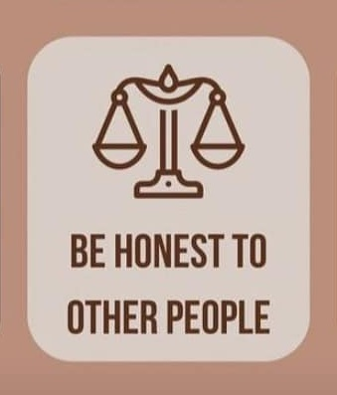
Be Honest
Ephesians 4:25
John 8:44
Revelation 21:8

Slide 13
Show Your Authentic Self
Colossians 3:3
Galatians 2:20

