Slide 1
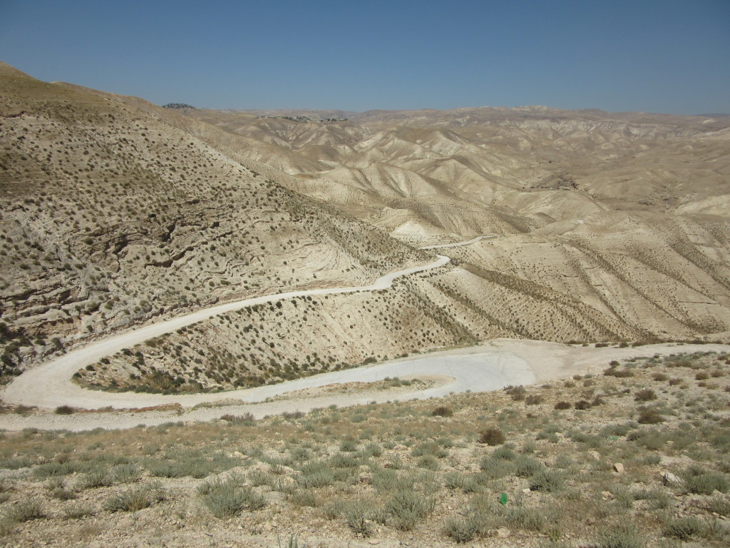
SIX FACES ALONG
THE JERICHO ROAD
Luke 10:25-37

Slide 2
SIX FACES ALONG
THE JERICHO ROAD
The Helpless Man:
The “Half-Dead” Victim
Luke 10:30
John 9:1-3
2nd Corinthians 12:7-10
James 5:14

Slide 3
SIX FACES ALONG
THE JERICHO ROAD
The Harmful Men:
The Thieves
Luke 10:30
Romans 1:28-32
1st Corinthians 6:9-11
Ephesians 4:28

Slide 4
SIX FACES ALONG
THE JERICHO ROAD
The Heedless Man:
The Priest
Luke 10:31
Proverbs 28:27
Hebrews 13:16
James 4:17

Slide 5
SIX FACES ALONG
THE JERICHO ROAD
The Heartless Man:
The Levite
Luke 10:32
1st John 4:17-18
Proverbs 21:13
Matthew 25:40-46

Slide 6
SIX FACES ALONG
THE JERICHO ROAD
The Helpful Man:
The Samaritan
Luke 10:33-34
John 4:9
Matthew 5:43-48
Philippians 2:4

Slide 7
SIX FACES ALONG
THE JERICHO ROAD
The Hidden Man:
The Innkeeper
Luke 10:35
Matthew 6:1-4
Ephesians 4:16
Proverbs 19:17

