Slide 1
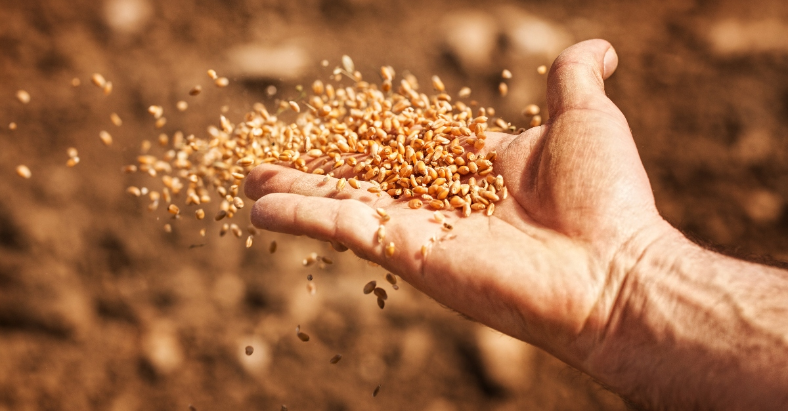
“Hear the Parable of the Sower”
Matthew 13:3-9

Slide 2
“Understand All the Parables”
Mark 4:13
Matthew 13:10-17, 34-35
Matthew 13:31-32, 33, 44, 47-52
Matthew 16:5-12

Slide 3
“He Himself Does Not Know How”
Mark 4:3
John 12:24
Acts 17:17
Mark 4:26-29

Slide 4
“The Seed Is the Word of God”
Luke 8:11
2nd Timothy 3:14-4:5

Slide 5
“Then the Devil Comes”
Luke 8:12; Matthew 13:19
Hebrews 4:2

Slide 6
“No Root”
Luke 8:13-14
Hebrews 10:26-31; 2nd Peter 2:20-22
Colossians 2:6-7

Slide 7
“Some a Hundredfold, Some Sixty, Some Thirty”
Matthew 13:8, 23
Acts 2:41
Acts 16:15
Acts 8:38

