Slide 1
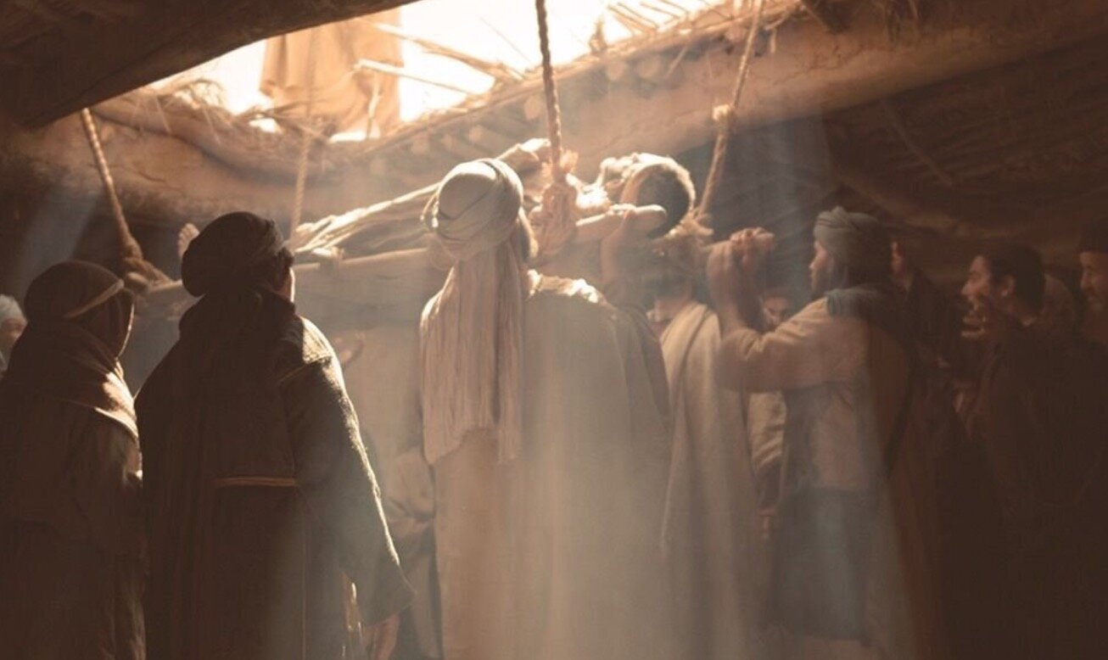
“THEY UNCOVERED THE ROOF”
Mark 2:1-12

Slide 2
“THEY UNCOVERED THE ROOF”
Seeking Jesus Is Most Important
Mark 2:2-4
Matthew 2:1-11; Luke 19:1-6
Matthew 7:7; Acts 17:26-28
Hebrews 13:10-13

Slide 3
“THEY UNCOVERED THE ROOF”
Friends Help Friends Find Jesus
Mark 2:3-4
John 1:35-49; 4:28-29, 39
1st Corinthians 15:33

Slide 4
“THEY UNCOVERED THE ROOF”
Nameless Others Assume Costs without Credit
Mark 2:3-4
Luke 10:35
Matthew 6:1-4

Slide 5
“THEY UNCOVERED THE ROOF”
Jesus’ Miracles Prove Him the Savior
Mark 2:5-12
John 20:30-31
Acts 2:22-39

