Slide 2
Introduction
1st Thessalonians 4:3
Romans 12:1-2; 1st John 2:15-17
Romans 6:17-22; Hebrews 12:14
1st Thessalonians 4:4
Romans 6:12-13
1st Corinthians 6:13_{b}-20
Genesis 39:7-12

Slide 3
Abstain from Flattery
Proverbs 7:1-5, 21-23
Proverbs 5:3-6
Genesis 2:18-24
Proverbs 25:11

Slide 4
Abstain from Immodesty
Genesis 2:16-17, 25; 3:6-7, 21
1st Timothy 2:9-10; Jeremiah 6:15
1st Peter 3:1-4; 2nd Corinthians 11:2
Proverbs 7:10

Slide 5
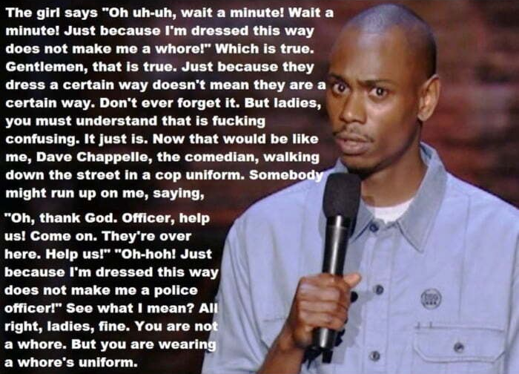

Slide 6
Abstain from Immodesty
Genesis 2:16-17, 25; 3:6-7,21
1st Timothy 2:9-10; Jeremiah 6:15
1st Peter 3:1-4; 2nd Corinthians 11:2
Proverbs 7:10
Exodus 20:26
Exodus 28:42; Nehemiah 4:18; Genesis 46:26
Proverbs 5:18-19
John 21:7-8

Slide 7
Abstain from Lust
2nd Samuel 11:2-5
Proverbs 6:25
Matthew 5:27-28
Job 31:1

Slide 8
Abstain from Lewdness
1st Peter 4:3; Galatians 5:19

Slide 9
Lewdness:
“…indecent bodily movements, unchaste handling of males and females…”

Slide 10
Abstain from Lewdness
1st Peter 4:3; Galatians 5:19
Ecclesiastes 3:4; Luke 7:32; Mark 6:22

Slide 11
HITCH2005
“Women relate dancing to sex.”

Slide 12
Abstain from Lewdness
1st Peter 4:3; Galatians 5:19
Ecclesiastes 3:4; Luke 7:32; Mark 6:22
Ecclesiastes 3:5
1st Thessalonians 5:26

Slide 13
Conclusion
Song of Songs 8:4
1st Corinthians 7:2
Ephesians 5:3-5

