Slide 1
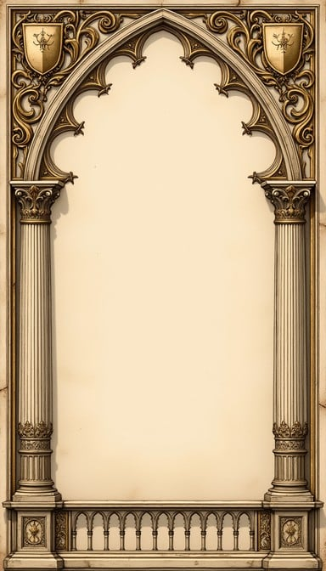
“HIS NAME WAS BOAZ”

Slide 2
“HIS NAME WAS BOAZ”
Boaz was polite to his employees.
Ruth 2:1-4
Colossians 4:1

Slide 3
“HIS NAME WAS BOAZ”
Boaz was kind to the poor.
Ruth 2:8-9, 14-16
1st Timothy 6:17-19
Isaiah 1:17; James 1:27

Slide 4
“HIS NAME WAS BOAZ”
Boaz listened to good reports.
Ruth 2:5-7, 11
Proverbs 22:1
Philippians 4:8

Slide 5
“HIS NAME WAS BOAZ”
Boaz listened was prompt in duty.
Ruth 3:18
James 4:13-17

Slide 6
“HIS NAME WAS BOAZ”
Boaz lived uprightly in a perverse society.
Ruth 1:1; Judges 21:25
Philippians 2:15

