Slide 1
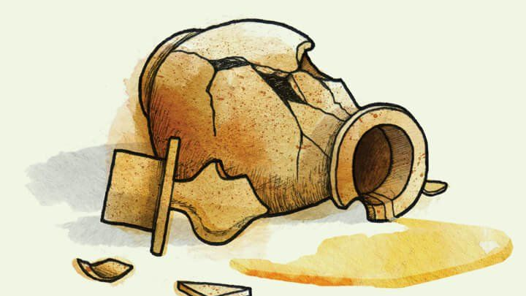
Mary of Bethany Meeting the Messiah

Slide 2
Mary of Bethany Meeting the Messiah
Mark 14:3-9

Slide 3
Where were they?
Matthew 26:6
    Leviticus 13:45-46
    Luke 7:20-22
John 12:1; 11:43-44

Slide 4
Who was this Mary?
Matthew 26:7; Mark 14:3
John 12:1-3; 11:1-2
Luke 7:36-50

Slide 5
What did she do?
Matthew 26:7; John 12:3
Mark 14:3
John 12:5
    Matthew 20:2, 9-12
    Exodus 20:9

Slide 6
Why did she anoint Him?
Matthew 26:8
    John 12:4-5; 17:12
    Isaiah 5:20
    1st John 3:11-12
    Luke 17:3; 19:37-40

Slide 7
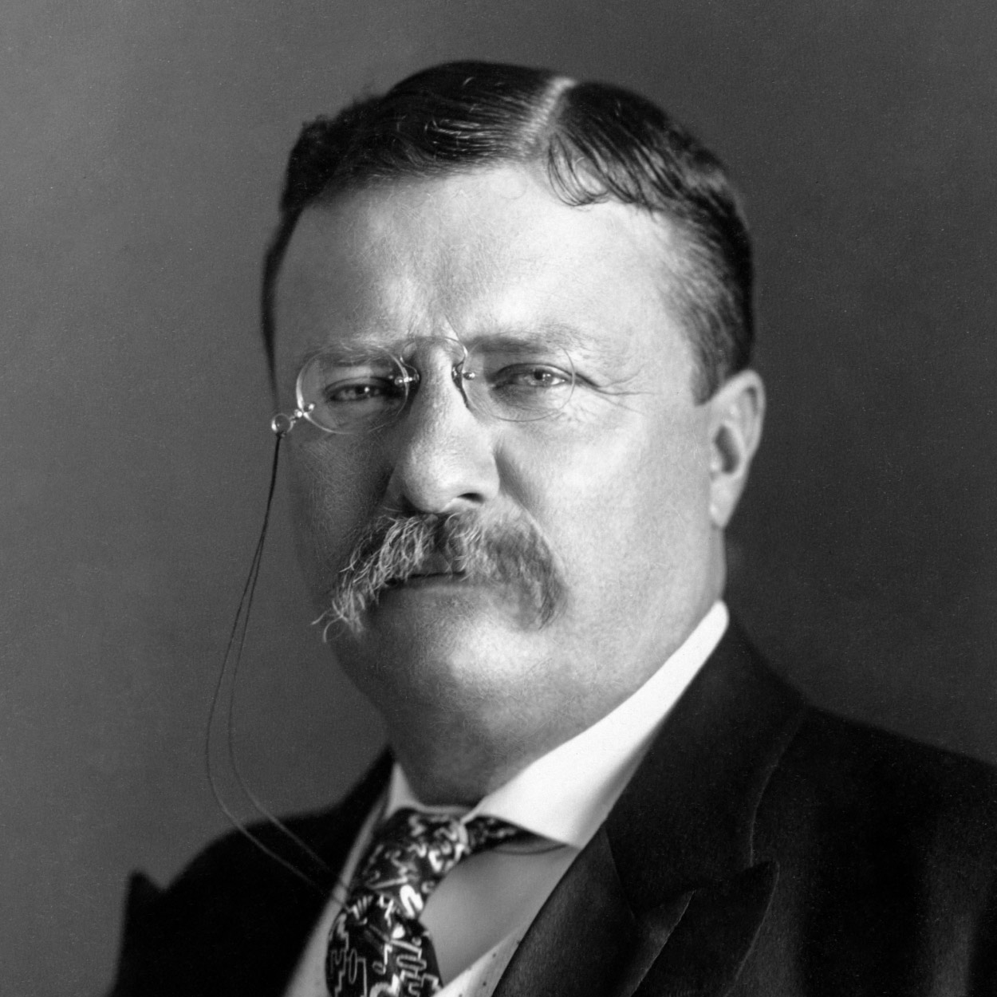
“The poorest way to face life is to face it with a sneer. There are many men who feel a kind of twisted pride in cynicism; there are many who confine themselves to criticism of the way others do what they themselves dare not even attempt. There is no more unhealthy being, no man less worthy of respect, than he who either really holds, or feigns to hold, an attitude of sneering disbelief toward all that is great and lofty, whether in achievement or in that noble effort which, even if it fails, comes second to achievement. A cynical habit of thought and speech, a readiness to criticize work which the critic himself never tries to perform, an intellectual aloofness which will not accept contact with life’s realities—all these are marks, not as the possessor would fain to think, of superiority, but of weakness. They mark the men unfit to bear their part painfully in the stern strife of living, who seek, in the affectation of contempt for the achievement of others, to hide from others and from themselves their own weakness. The role is easy; there is none easier, save only the role of the man who sneers alike at both criticism and performance. …

Slide 8
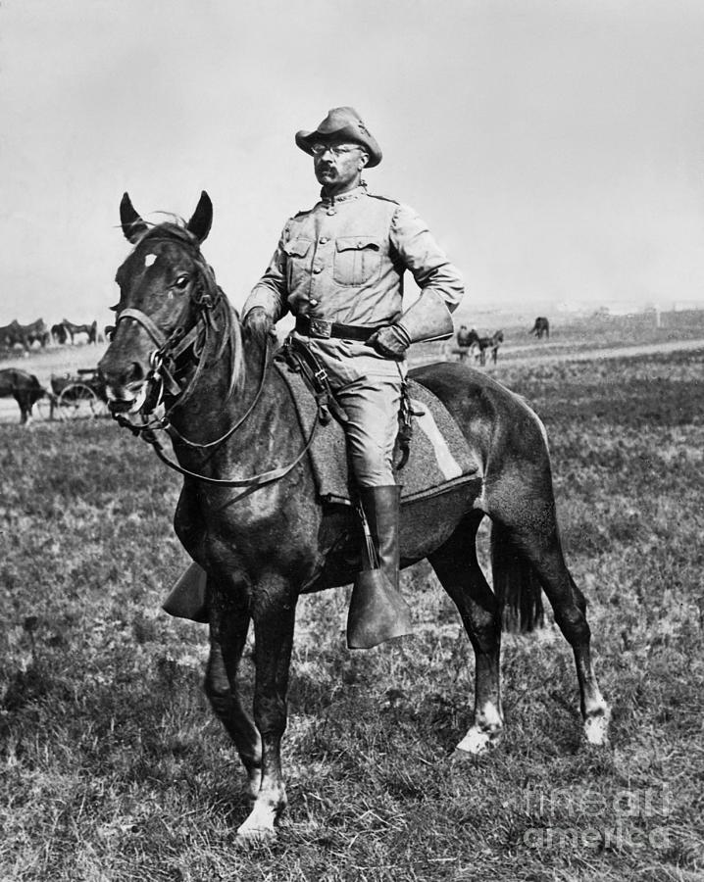
It is not the critic who counts; not the man who points out how the strong man stumbles, or where the doer of deeds could have done them better. The credit belongs to the man who is actually in the arena, whose face is marred by dust and sweat and blood; who strives valiantly; who errs, who comes short again and again, because there is no effort without error and shortcoming; but who does actually strive to do the deeds; who knows the great enthusiasms, the great devotions; who spends himself in a worthy cause; who at the best knows in the end the triumph of high achievement, and who at the worst, if he fails, at least fails while daring greatly, so that his place shall never be with those cold and timid souls who neither know victory nor defeat.

Slide 9
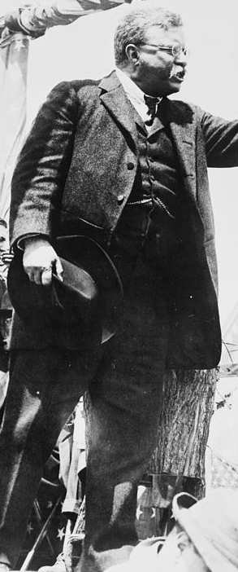
Shame on the man of cultivated taste who permits refinement to develop into fastidiousness that unfits him for doing the rough work of a workaday world. Among the free peoples who govern themselves there is but a small field of usefulness open for the men of cloistered life who shrink from contact with their fellows. Still less room is there for those who deride or slight what is done by those who actually bear the brunt of the day; nor yet for those others who always profess that they would like to take action, if only the conditions of life were not exactly what they actually are. The man who does nothing cuts the same sordid figure in the pages of history, whether he be cynic, or fop, or voluptuary. There is little use for the being whose tepid soul knows nothing of the great and generous emotion, of the high pride, the stern belief, the lofty enthusiasm, of the men who quell the storm and ride the thunder. Well for these men if they succeed; well also, though not so well, if they fail, given only that they have nobly ventured, and have put forth all their heart and strength. It is war-worn Hotspur, spent with hard fighting, he of the many errors and the valiant end, over whose memory we love to linger, not over the memory of the young lord who ‘but for the vile guns would have been a valiant soldier.’”

Slide 10
Why did she anoint Him?
Mark 14:6_{a}; Proverbs 6:16-19
Matthew 26:10; 2nd Timothy 3:16-17
Mark 14:8; Matthew 25:14-30
Matthew 26:12; 25:31-40
Mark 14:9

