Slide 1
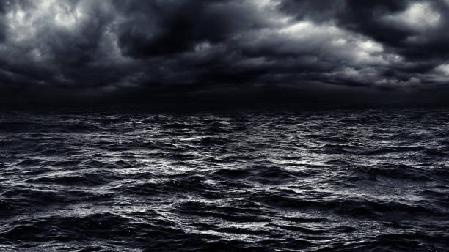
SAVED LIKE NOAH

Slide 2
SAVED LIKE NOAH
1st Peter 3:20-21

Slide 3
SAVED LIKE NOAH
Saved By Grace
1st Peter 3:20-21
Titus 2:11-12
Ephesians 2:8-10

Slide 4
SAVED LIKE NOAH
Saved By Faith
Hebrews 11:7
Genesis 2:4-6; 7:11
Hebrews 11:1;
2nd Corinthians 5:7
Hebrews 11:6

Slide 5
SAVED LIKE NOAH
Saved By Fear
Hebrews 11:7
Philippians 2:12
Ecclesiastes 12:13
Acts 10:35

Slide 6
SAVED LIKE NOAH
Saved By Obedience
Hebrews 11:7
Genesis 6:14-7:5
Luke 6:46-49

Slide 7
SAVED LIKE NOAH
Saved Through Water
1st Peter 3:20-21; Genesis 7:17
John 3:1-7

