Slide 1
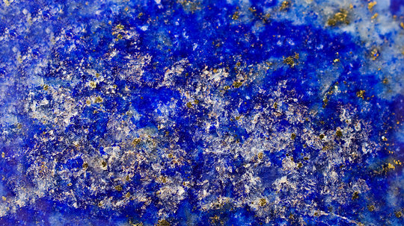
SEEKING THE KINGDOM

Slide 2
Introduction
Matthew 6:33
Matthew 16:18-19

Slide 3
Find a Church with a Name Recognizable in Scripture
Ephesians 5:24
John 3:27
Matthew 16:18; Acts 20:28; Colossians 1:18
Romans 16:16; 1st Corinthians 1:2; 1st Timothy 3:15
Romans 16:1; 1st Corinthians 16:1, 19; Colossians 4:16
1st Thessalonians 2:14

Slide 4
Find a Church Teaching the Gospel Plan of Salvation
Ephesians 5:23; 1:22-23
1st Corinthians 12:13; Galatians 3:27
Acts 18:8; 22:16; 2:38

Slide 5
Find a Church Worshiping According to the New Testament
1st Corinthians 14:16, (4, 5, 12, 19, 23 ,28 ,35); Colossians 3:16
Acts 20:7; 1st Corinthians 11:17-26
Acts 12:5; 2:42; Ephesians 5:20

Slide 6
Find a Church Whose Members Live in Moral Purity
Hebrews 10:24-25; Titus 3:14
Matthew 18:15-17; 1st Corinthians 6:1-11

Slide 7
Conclusion
Matthew 13:34-35
Matthew 7:7

