Slide 1
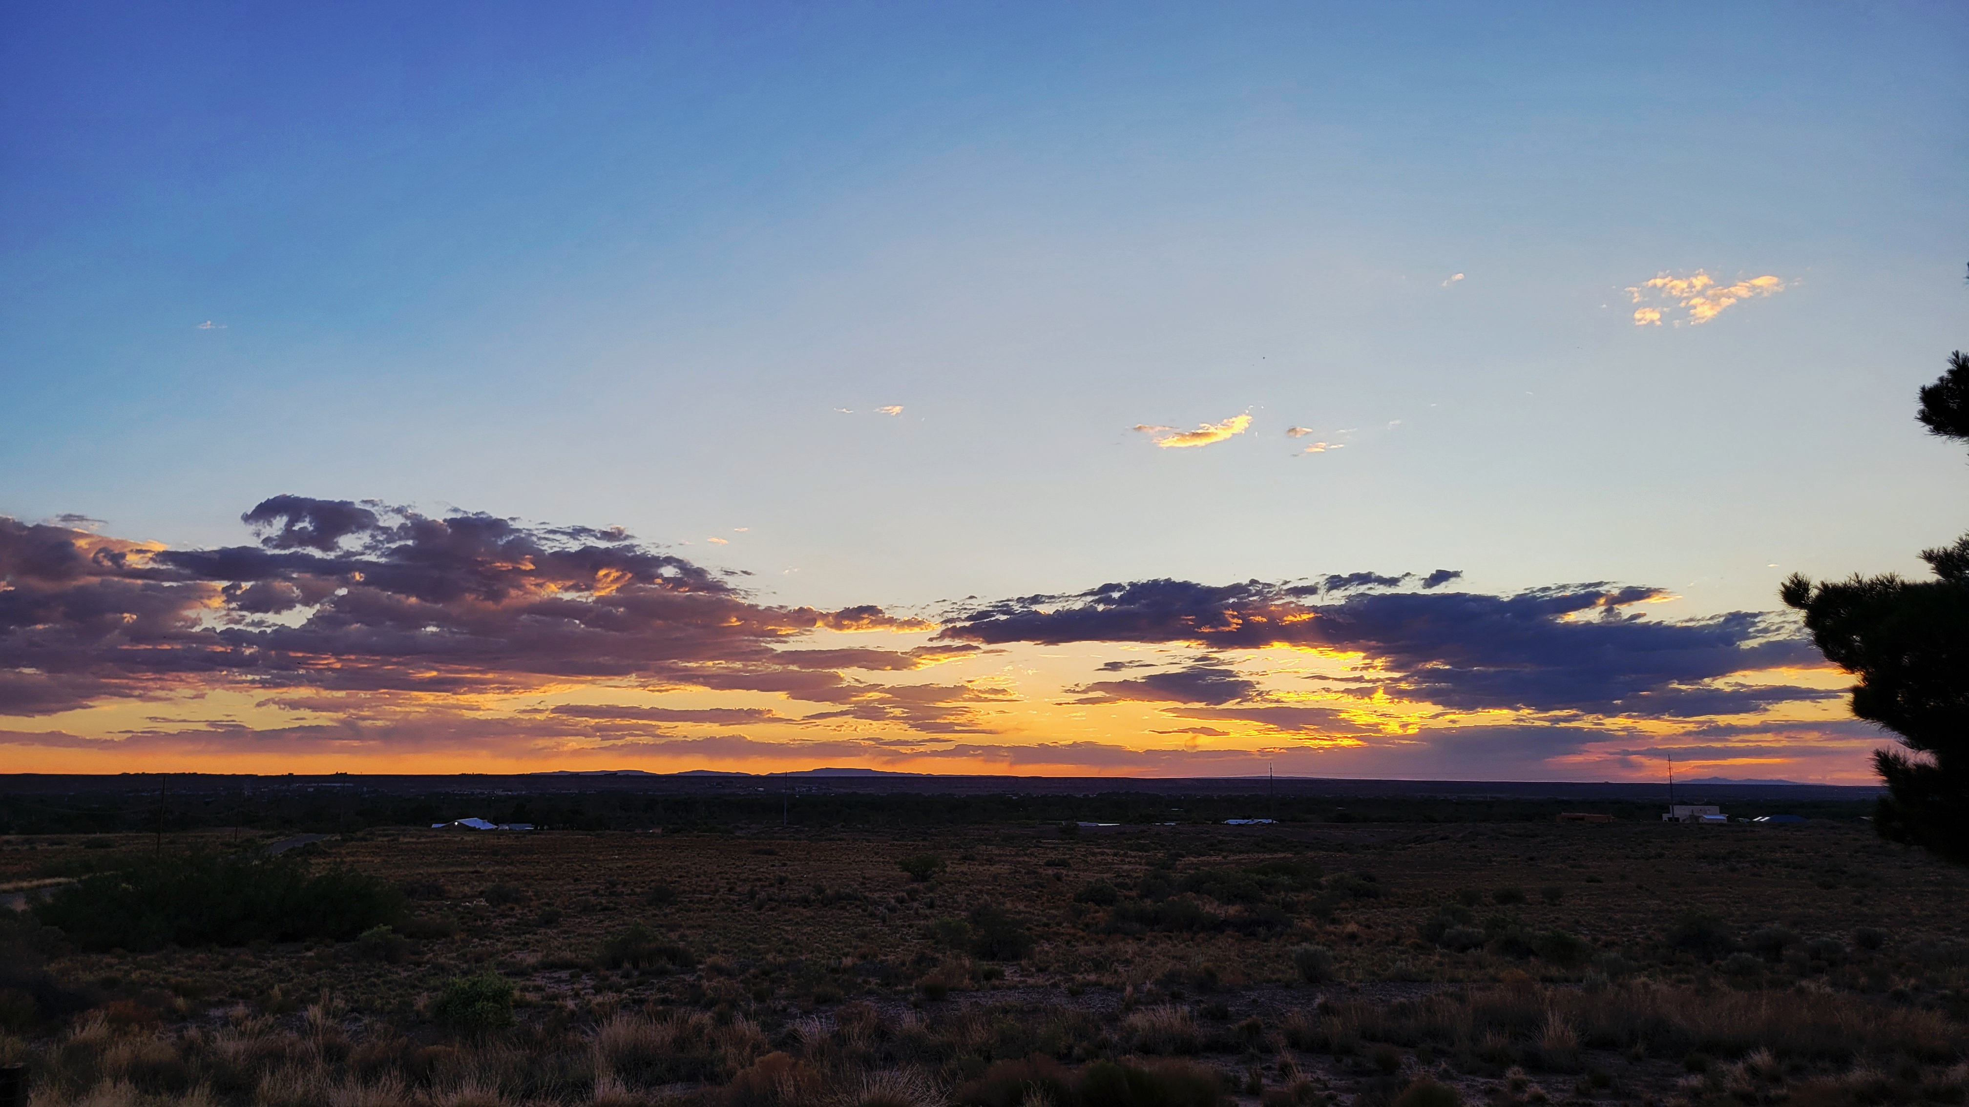
MESSIANIC MILESTONES
THE ARREST OF THE MESSIAH

Slide 2
THE ARREST OF THE MESSIAH
Where was He arrested?
Luke 22:39; Mark 14:32
Mark 14:49
John 18:1-2

Slide 3
THE ARREST OF THE MESSIAH
Who was present at His arrest?
Luke 22:39
Matthew 26:47-50_{a}; Luke 22:47-48
Psalm 41:9
John 13:18-30
Mark 14:43; John 18:3

Slide 4
THE ARREST OF THE MESSIAH
When was He arrested?
John 18:3
Luke 22:53
Matthew 26:47

Slide 5
THE ARREST OF THE MESSIAH
How did His arrest happen?
John 18:4-9
John 18:10-11; 2nd Corinthians 10:3-6
Luke 22:49-51; Matthew 5:44
Matthew 26:51-54; Luke 22:36-38; 2nd Kings 19:35

Slide 6
THE ARREST OF THE MESSIAH
Why was He arrested?
Luke 22:3-6
John 11:45-53
John 10:17-18

