Slide 1
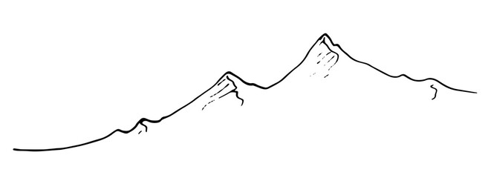
Upon Mount Moriah

Slide 2
Upon Mount Moriah, Abraham Sacrificed Isaac
Genesis 22:1-19
James 2:20-24
Hebrews 11:17-19

Slide 3
Upon Mount Moriah, David Sacrificed at Ornan’s Threshing Floor
2nd Chronicles 3:1
1st Chronicles 21:1-30
Numbers 26:1-4
Malachi 1:6-14

Slide 4
Upon Mount Moriah, Solomon Built the Temple
2nd Chronicles 3:1
2nd Samuel 7:-17
1st Chronicles 22:1-19

Slide 5
Upon Mount Moriah, the Church Began to Assemble
Acts 2:40-47
Ephesians 3:10-11, 21

