Slide 1
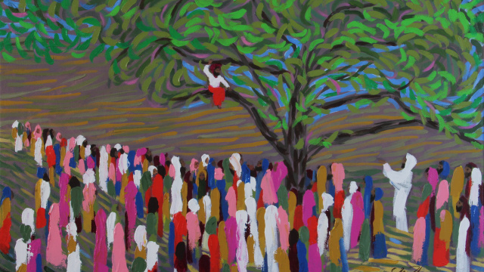
ZACCHAEUS
Meeting the Messiah

Slide 2
ZACCHAEUS
Meeting the Messiah
Luke 19:1-10

Slide 3
WHO WAS ZACCHAEUS?
Luke 19:2
Luke 3:3, 12-13
Luke 5:30; 7:34; 15:1

Slide 4
WHERE WAS ZACCHAEUS?
Luke 19:3-4
Acts 17:24-27; Matthew 7:7-11

Slide 5
HOW DID ZACCHAEUS BEHAVE?
Luke 19:6
John 1:12
Acts 2:41

Slide 6
WHAT DID ZACCHAEUS DO?
Luke 19:8
Ephesians 4:28
Matthew 3:8

Slide 7
WHY DID ZACCHAEUS GET JESUS’ ATTENTION?
Luke 19:7, 9-10
1st Timothy 1:12-16;
Romans 5:6-11

