Slide 1


Slide 2
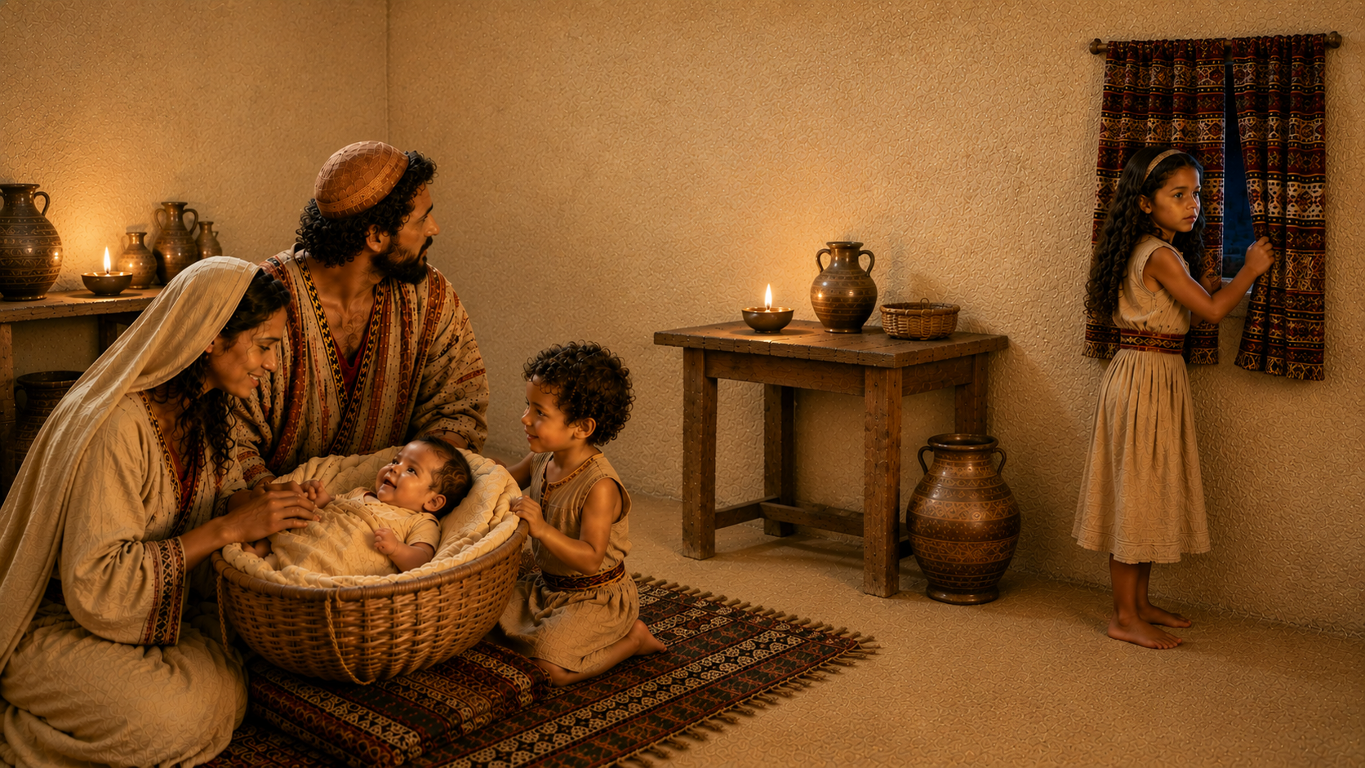
“BY FAITH, MOSES
Was Hidden… By His Parents”
Hebrews 11:23
2nd Timothy 1:5; 3:14-15
Deuteronomy 11:18-21

Slide 3

“BY FAITH, MOSES
Refused to Be Called the Son of Pharaoh’s Daughter”
Hebrews 11:24-26
2nd Corinthians 6:14-18
Matthew 19:29

Slide 4
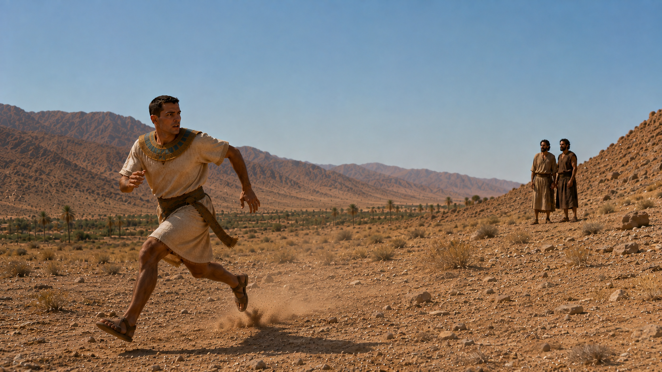
“BY FAITH, MOSES
Forsook Egypt”
Hebrews 11:27
Philippians 3:7-8
Luke 14:33

Slide 5
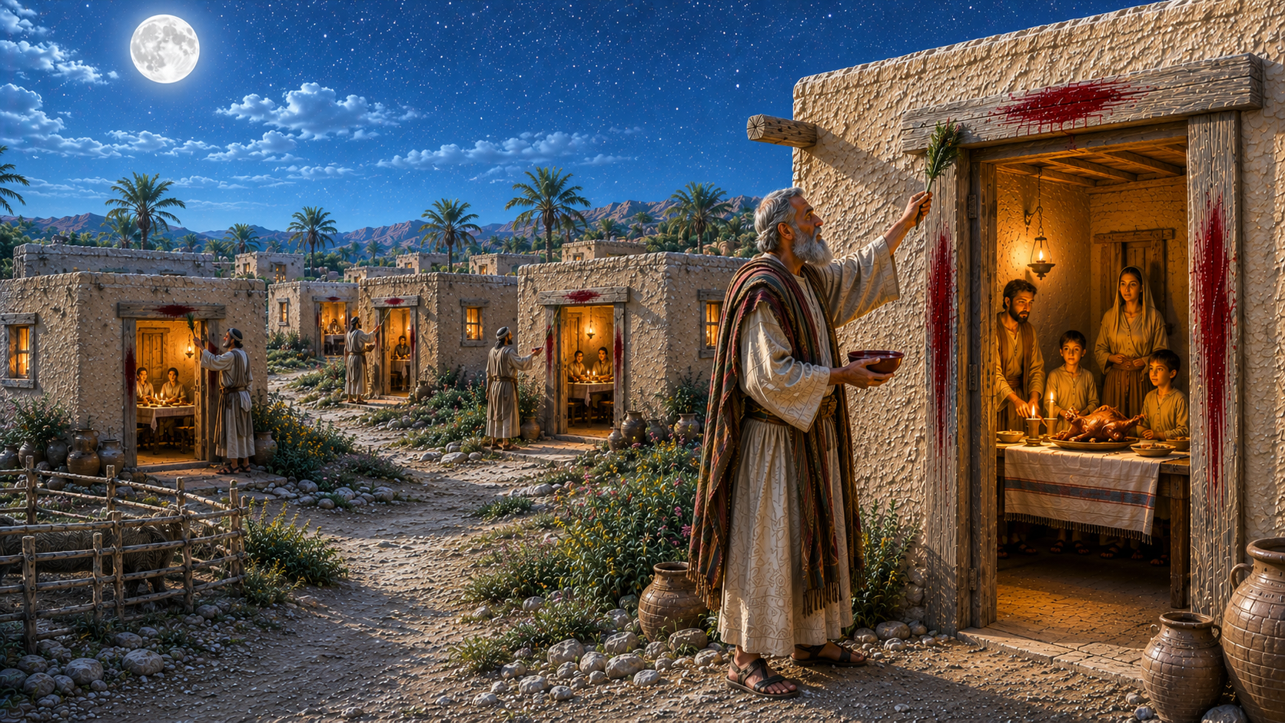
“BY FAITH, MOSES
Kept the Passover”
Hebrews 11:28
Exodus 12:1-30
Psalm 103:17-18
1st Corinthians 5:7

Slide 6
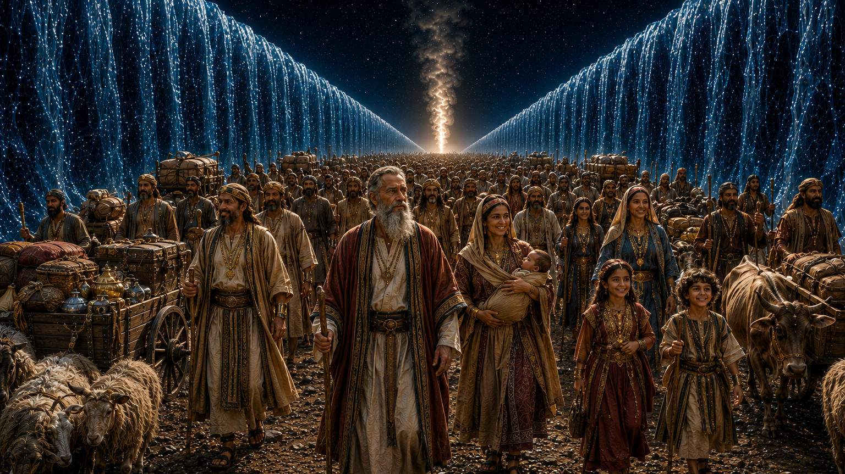
“BY FAITH, MOSES
Passed Through the Red Sea”
Hebrews 11:29
Exodus 14:21-15:21
1st Corinthians 10:1-13

