Slide 1


Slide 2

Not All Wine Is the Same
Psalm 104:14-15
Isaiah 65:8
Proverbs 23:31

Slide 3
God Forbids Drunkenness
1st Corinthians 6:9-11
Galatians 5:17-23

Slide 4
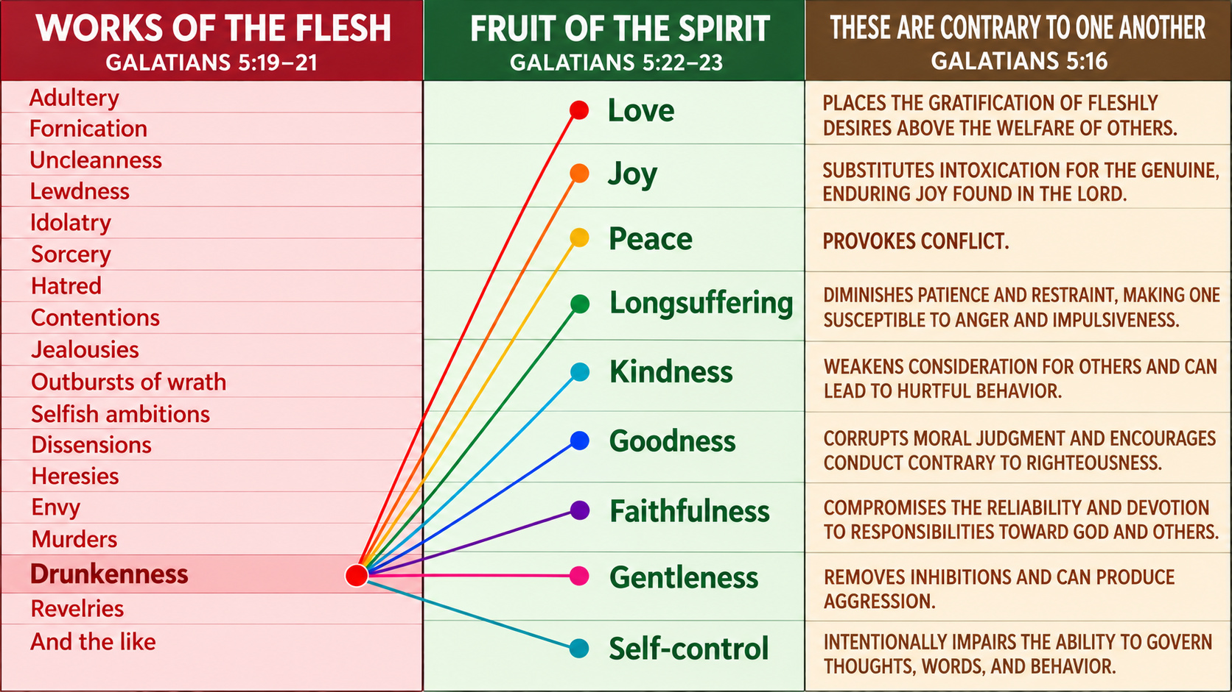

Slide 5
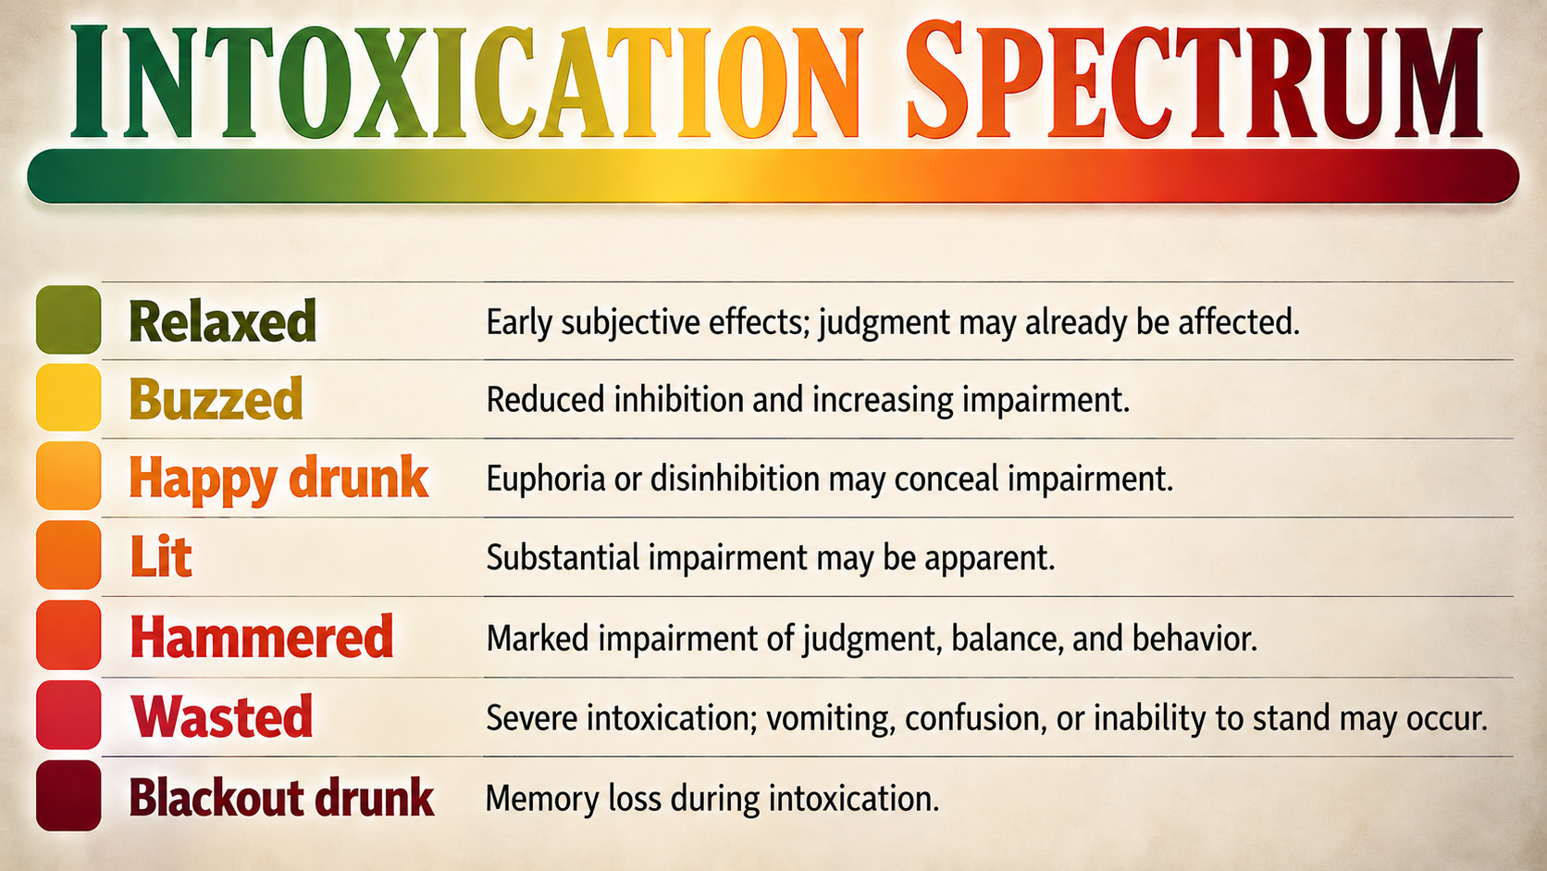

Slide 6
Drinking Causes Vulnerability
Proverbs 23:29-35
Genesis 9:20-25
Genesis 19:30-36
1st Kings 16:9-10

Slide 7
Temptation Must Be Avoided
Romans 13:13-14
Proverbs 22:3
James 4:7
Romans 14:21

Slide 8
The Exception Is Narrow
1st Timothy 5:23
Luke 10:34

Slide 9
God Commands Sobriety
Titus 2:11-13
1st Peter 5:8

Slide 10
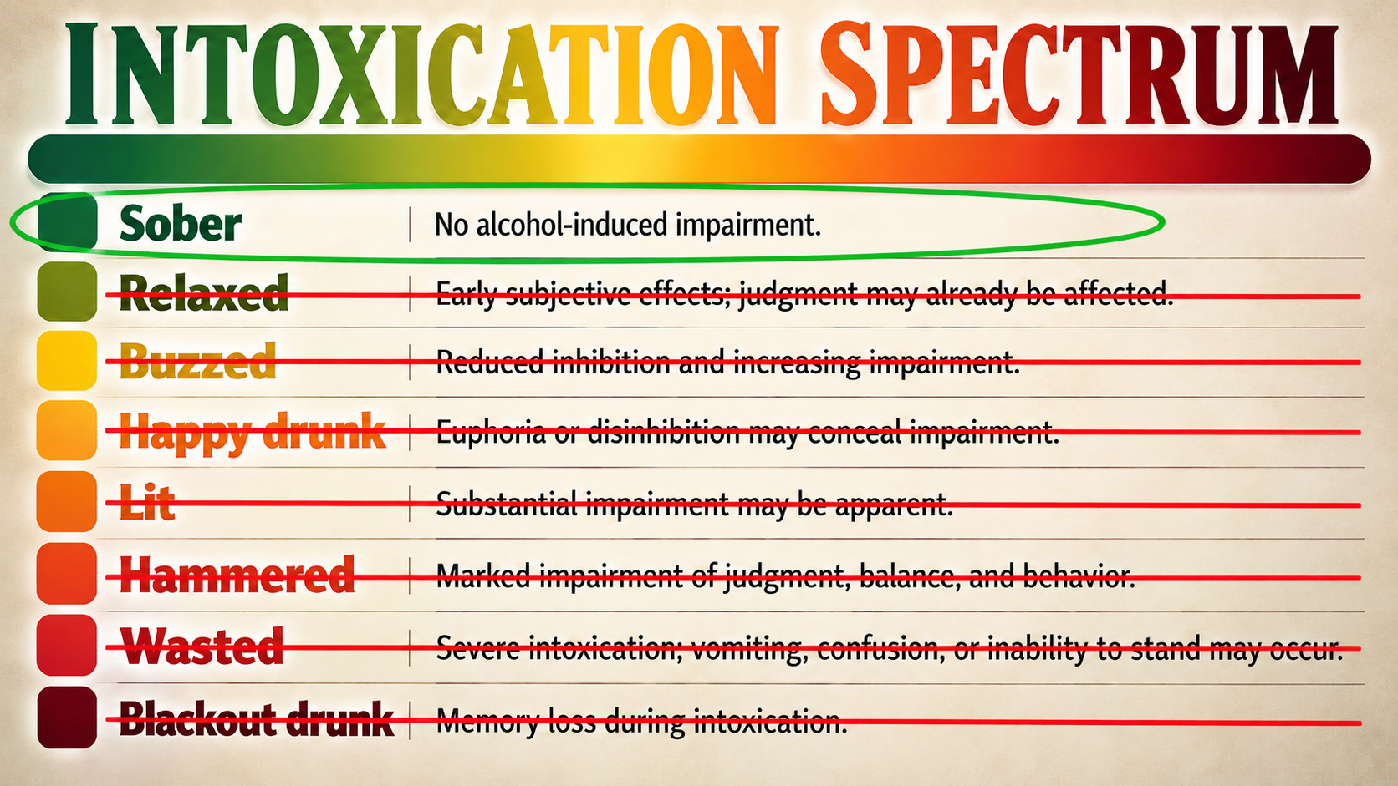

Slide 11
Alcohol Displaces the Holy Spirit
Ephesians 5:18
Galatians 5:16

