Slide 1
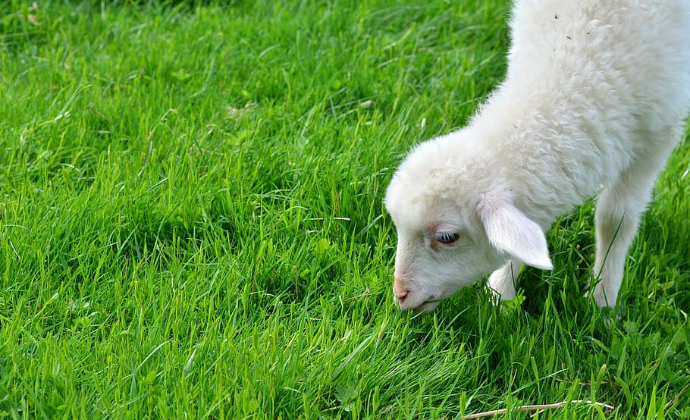
“JEHOVAH IS MY SHEPHERD”

Slide 2
“Jehovah Is My Shepherd”
Psalm 23:1_{a}
Deuteronomy 32:9-12
Psalm 100:3

Slide 3
“I Shall Not Want”
Psalm 23:1_{b}
Psalm 37:25
Luke 12:22-34

Slide 4
“He Makes Me to Lie Down in Green Pastures”
Psalm 23:2_{a}
1st Samuel 17:34-36
Ezekiel 34:15-22
John 10:1-18

Slide 5
“He Leads Me Beside the Still Waters”
Psalm 23:2_{b}
Jeremiah 2:13
Psalm 63:1
Genesis 29:1-10

Slide 6
“He Restores My Soul”
Psalm 23:3_{a}
Luke 15:1-7
Psalm 42:11
Proverbs 27:23

Slide 7
“He Leads Me in the Paths of Righteousness for His Name’s Sake”
Psalm 23:3_{b}
Isaiah 53:6
John 14:6
Mark 8:34

Slide 8
“Yea, Though I Walk Through the Valley of the Shadow of Death, I Will Fear No Evil; For You Are with Me”
Psalm 23:4_{a}
James 1:12
Matthew 28:20

Slide 9
“Your Rod and Your Staff, They Comfort Me”
Psalm 23:4_{b}
Ezekiel 20:37-38
Psalm 89:32

Slide 10
“You Prepare a Table Before Me in the Presence of My Enemies”
Psalm 23:5_{a}
Matthew 15:27
Ezekiel 34:15
Luke 13:28-29

Slide 11
“You Anoint My Head with Oil; My Cup Runs Over”
Psalm 23:5_{b}
Luke 10:34
2nd Corinthians 1:21-22; 1st John 2:20-21

Slide 12
“Surely Goodness and Mercy Shall Follow Me All The Days of My Life”
Psalm 23:6_{a}
Matthew 5:16

Slide 13
“And I Will Dwell in the House of Jehovah Forever”
Psalm 23:6_{b}
John 2:14
2nd Samuel 12:3
John 14:2-3

