Slide 1


Slide 2

Moses Escaped the Massacre of the Innocents
Exodus 1:15-2:10
1st Peter 2:13-14
Acts 4:18-20; 5:27-29
Psalm 19:7
Hebrews 11:23
Joshua 2:1-7; 1st Samuel 19:11-14

Slide 3

Moses Escaped Pharaoh’s Vengeance
Exodus 2:11-15; 4:19
Hebrews 11:24-27
Acts 7:22-28
Ecclesiastes 3:1, 3

Slide 4
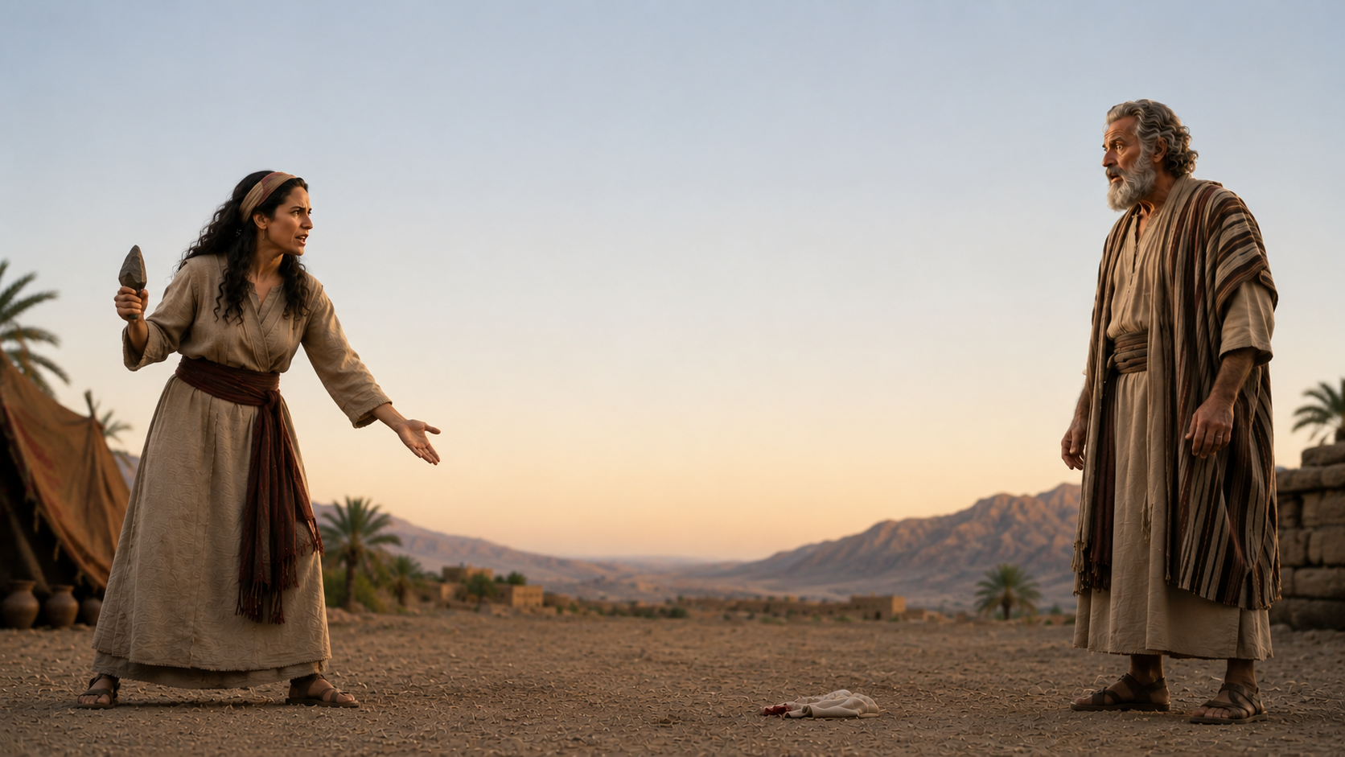
Moses Escaped
God’s Punishment
Exodus 4:24-26
Genesis 17:9-14
James 4:17
Romans 6:23
Proverbs 31:10-11
2nd Corinthians 5:16

