Slide 1

psalm 19
Date

Slide 2
psalm 19
GOD IS REVEALED IN NATURE
Psalm 19:1-6
Romans 1:20
Date

Slide 3
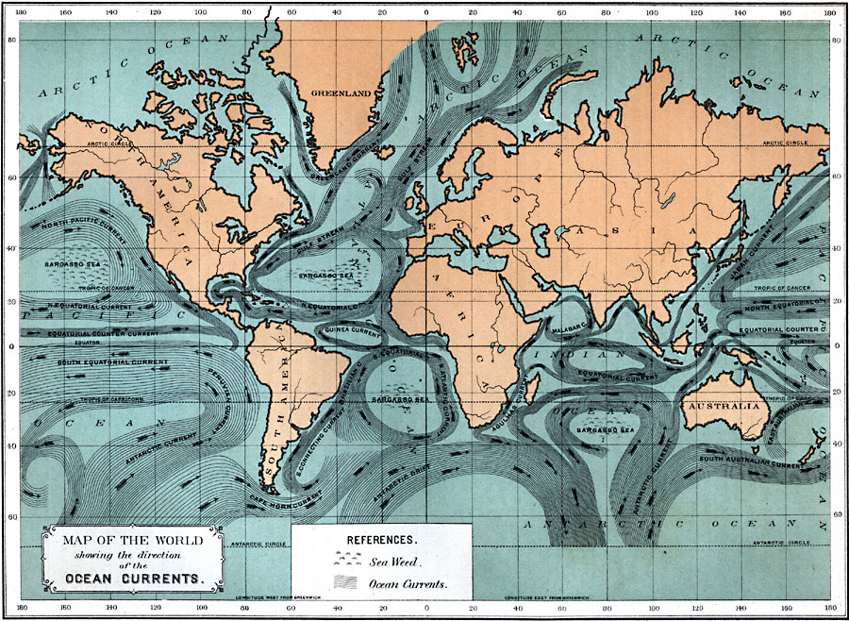
psalm 19
GOD IS REVEALED IN NATURE
Psalm 8:8; Isaiah 43:16
Date

Slide 4
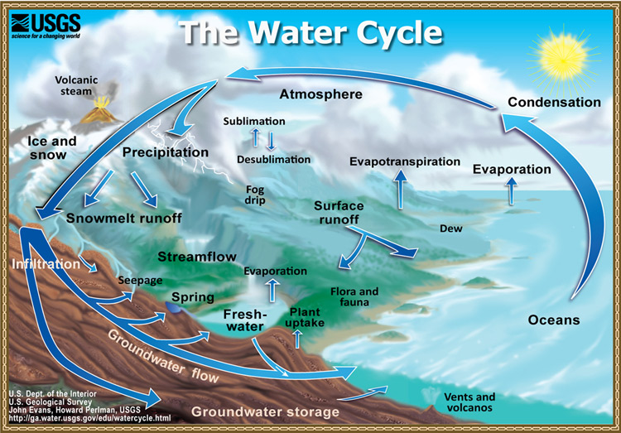
psalm 19
GOD IS REVEALED IN NATURE
Job 36:27-28; Amos 5:8; 9:6; Ecclesiastes 1:7
Date

Slide 5
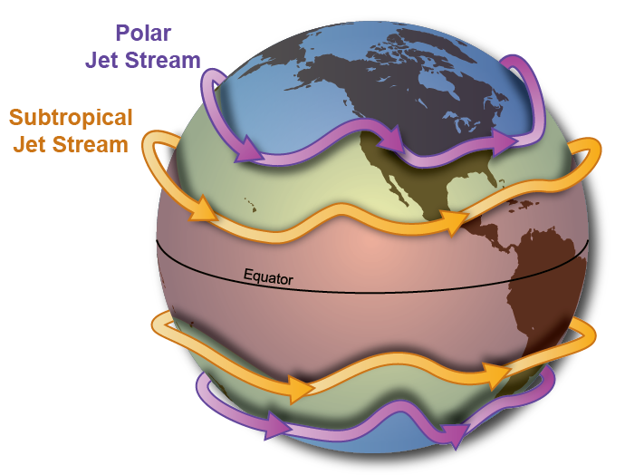
psalm 19
GOD IS REVEALED IN NATURE
Ecclesiastes 1:6
Date

Slide 6
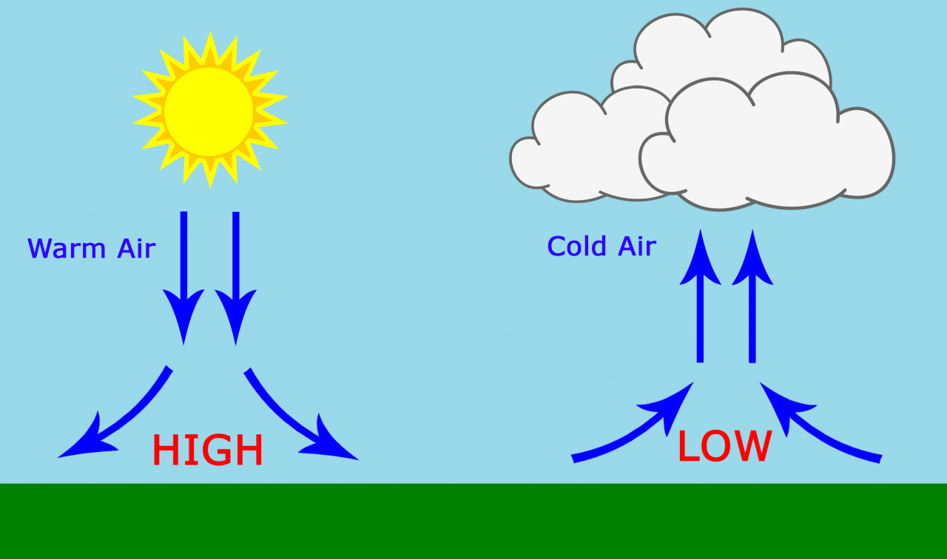
psalm 19
GOD IS REVEALED IN NATURE
Job 28:25
Date

Slide 7
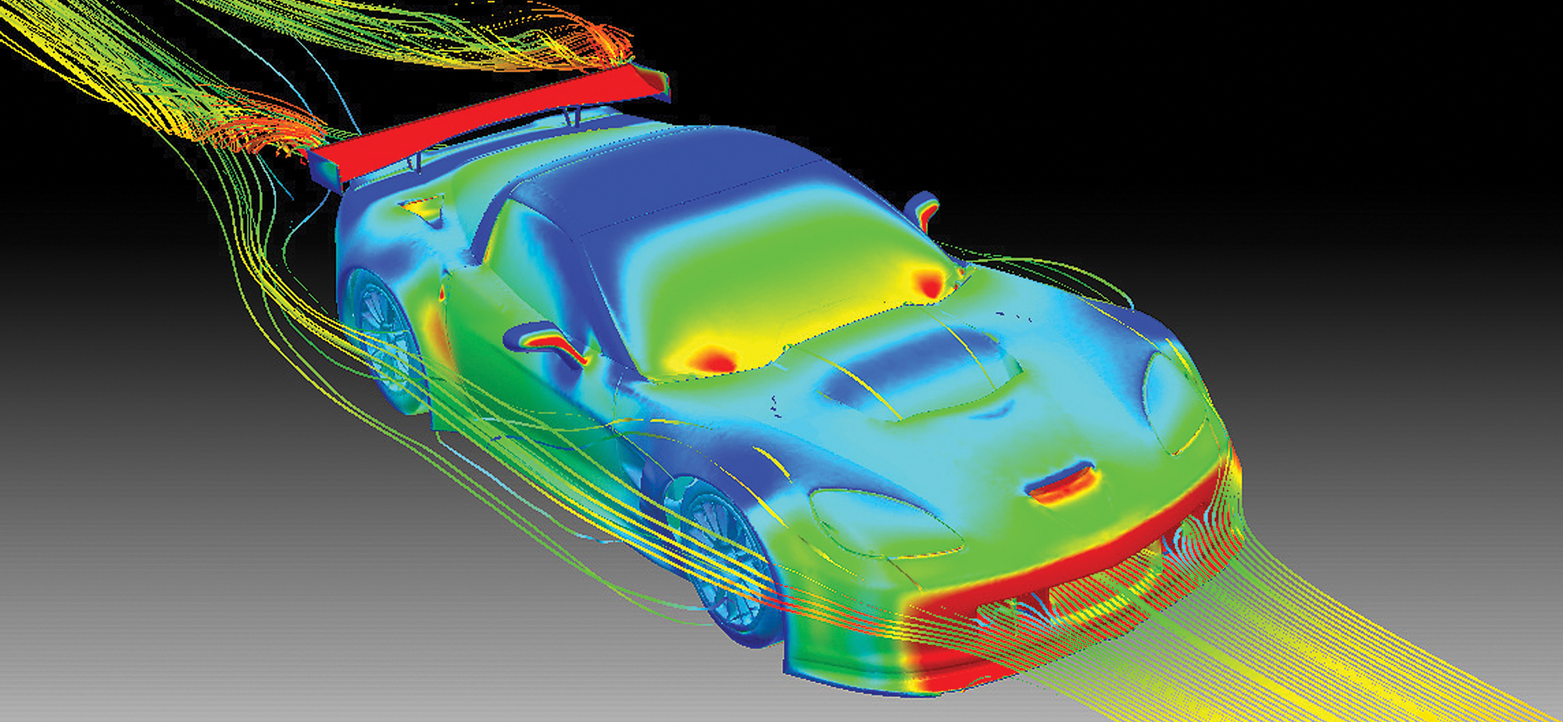
psalm 19
GOD IS REVEALED IN NATURE
Job 28:25
Date

Slide 8
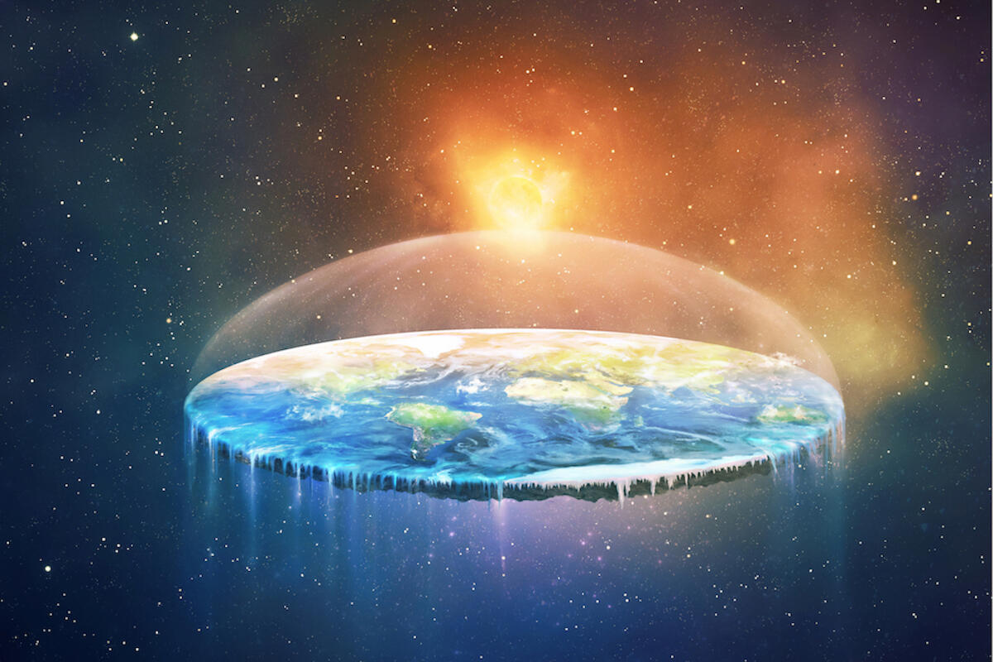
psalm 19
GOD IS REVEALED IN NATURE
Job 26:10; Proverbs 8:27; Isaiah 40:22
Date

Slide 9
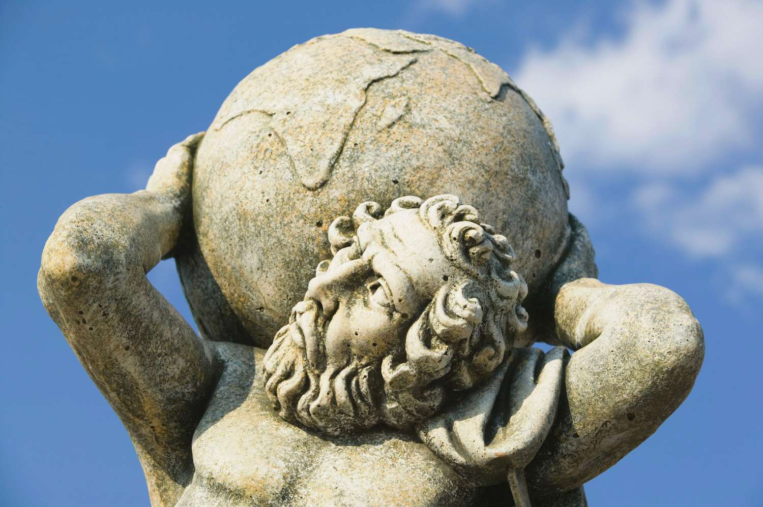
psalm 19
GOD IS REVEALED IN NATURE
Job 26:7
Date

Slide 10
psalm 19
GOD IS REVEALED IN NATURE
Colossians 1:16-17
Date

Slide 11

psalm 19
GOD IS REVEALED IN HIS WORD
Psalm 19:7-14

Slide 12
psalm 19
GOD IS REVEALED IN HIS WORD
Psalm 19:7-14
God’s Word Is | What it Is Doing | Why it Can
Law | Converting the Soul | Perfect
Testimony | Making Wise the Simple | Sure
Statutes | Rejoicing the Heart | Right
Commandment | Enlightening the Eyes | Pure
Fear | Enduring Forever | Clean
Judgments | Making Righteous | True

Slide 13
psalm 19
GOD IS REVEALED IN HIS WORD
Psalm 19:7-14
2nd Timothy 3:16-17
Psalm 119:160; 1st Peter 1:25; Luke 21:33
Proverbs 1:7

