Slide 1
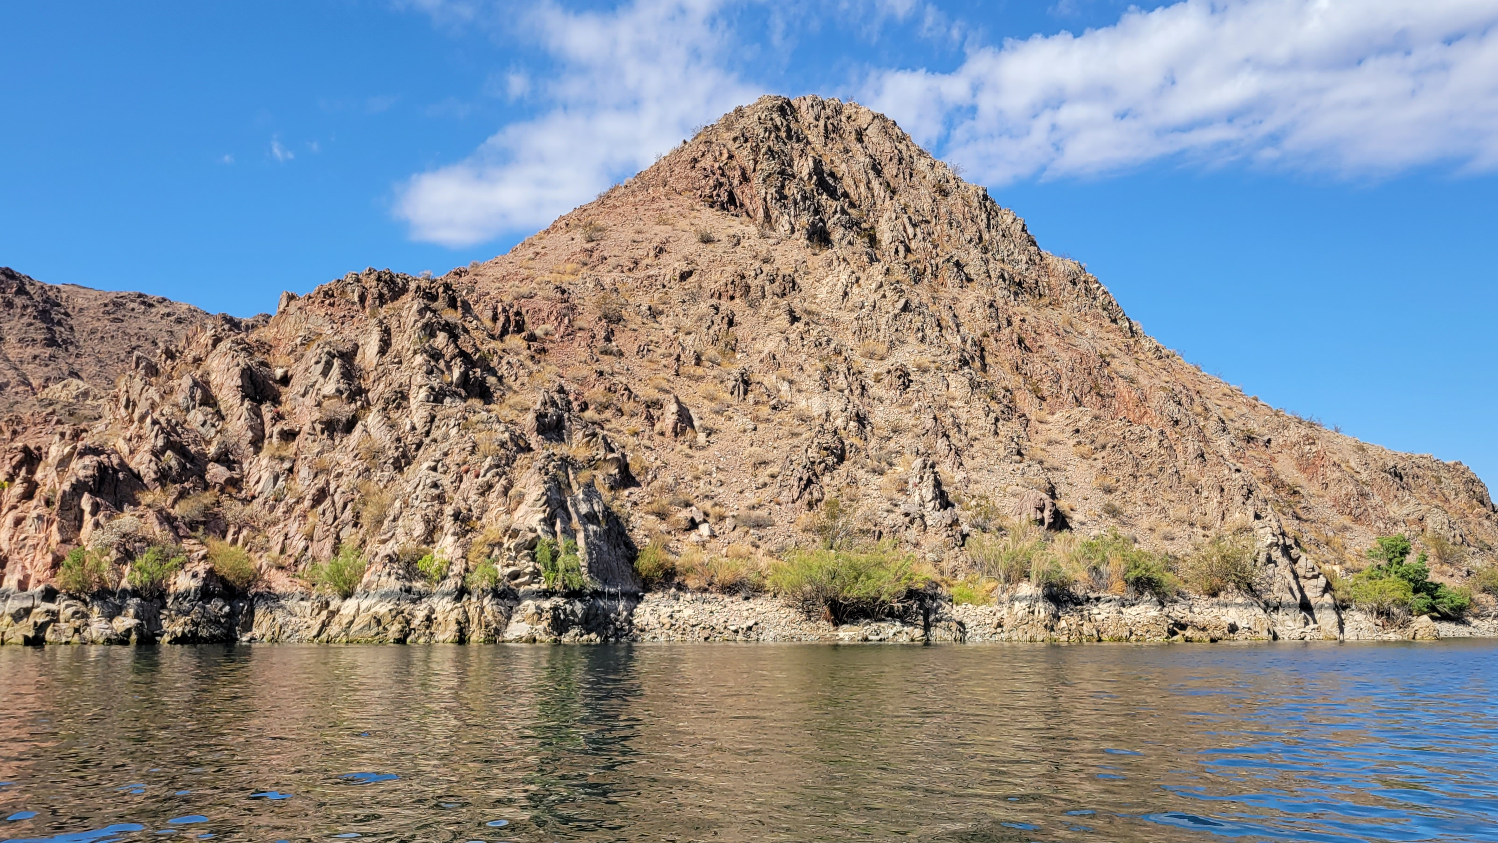
COLOSSIANS 3

Slide 2
COLOSSIANS 3
#1
Upon what do the following instructions depend?

Slide 3
COLOSSIANS 3
#2
Why should a Christian seek things above?

Slide 4
COLOSSIANS 3
#3
What is Christ doing now?

Slide 5
COLOSSIANS 3
#4
Whose responsibility is one’s state of mind?

Slide 6
COLOSSIANS 3
#5
What does a Christian not need to be mentally focused on?

Slide 7
COLOSSIANS 3
#6
Why should a Christian’s mindset be so?

Slide 8
COLOSSIANS 3
#7
What will happen to us at Christ’s next appearance?

Slide 9
COLOSSIANS 3
#8
What needs to happen to “your members which are on the earth?”

Slide 10
COLOSSIANS 3
#9
Which earthly members are enumerated by Paul?

Slide 11
COLOSSIANS 3
#10
Why should we “put to death” our earthly members?

Slide 12
COLOSSIANS 3
#11
What is the primary characteristic of “the new man?”

Slide 13
COLOSSIANS 3
#13
In contrast to what has been “put off,” what do God’s elect “put on?”

Slide 14
COLOSSIANS 3
#14
Why is love “above all these?”

Slide 15
COLOSSIANS 3
#15
Where should the peace of God prevail?

Slide 16
COLOSSIANS 3
#16
Where are the elect called to?

Slide 17
COLOSSIANS 3
#17
Before moving on from the list of put-ons, what else is commanded?

Slide 18
COLOSSIANS 3
#18
Comparing Colossians 3:16-17 with Ephesians 5:18-20, what is the equivalent of “Let the word of Christ dwell in you richly in all wisdom?”

Slide 19
COLOSSIANS 3
#19
What kind of music is authorized in New Testament worship?

Slide 20
COLOSSIANS 3
#20
To whom should singing be directed?

Slide 21
COLOSSIANS 3
#21
Explain what is meant by doing all in Jesus’ “name.”

Slide 22
COLOSSIANS 3
#22
How should prayer be addressed?

Slide 23
COLOSSIANS 3
#23
What is the duty of wives?

Slide 24
COLOSSIANS 3
#24
What is the duty of husbands?

Slide 25
COLOSSIANS 3
#25
What is the duty of children?

Slide 26
COLOSSIANS 3
#26
What is the duty of fathers?

Slide 27
COLOSSIANS 3
#27
What is the duty of bondservants?

Slide 28
COLOSSIANS 3
#28
Why should every action be done “heartily?”

Slide 29
COLOSSIANS 3
#29
What will become of the wrongdoer?

