Slide 1
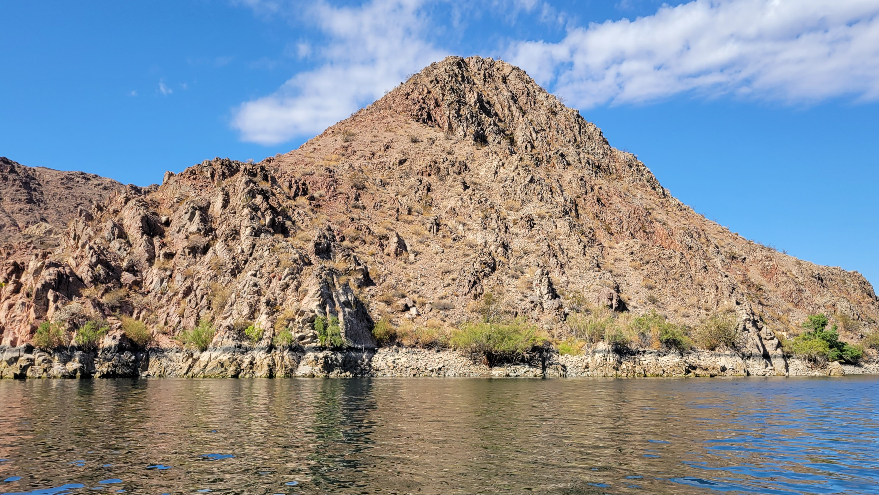
COLOSSIANS 4

Slide 2
COLOSSIANS 4
#1
What is the duty of masters?

Slide 3
COLOSSIANS 4
#2
How should our praying be characterized?

Slide 4
COLOSSIANS 4
#3
What did Paul request for himself and his companions?

Slide 5
COLOSSIANS 4
#4
How should our behavior in the presence of unbelievers be characterized?

Slide 6
COLOSSIANS 4
#5
How should our speech be characterized?

Slide 7
COLOSSIANS 4
#6
Who were Tychicus and Onesimus and what was their task?

Slide 8
COLOSSIANS 4
#7
Who were Aristarchus, Mark, and Jesus Justus, collectively and individually?

Slide 9
COLOSSIANS 4
#8
Who else saluted the Colossian brethren?

Slide 10
COLOSSIANS 4
#9
Whom were the Colossians told to greet on Paul’s behalf?

Slide 11
COLOSSIANS 4
#10
What interaction did Paul want the Colossians and Laodiceans to undertake?

Slide 12
COLOSSIANS 4
#11
What charge was given to Archippus?

Slide 13
COLOSSIANS 4
#12
How does the epistle conclude?

