Slide 1
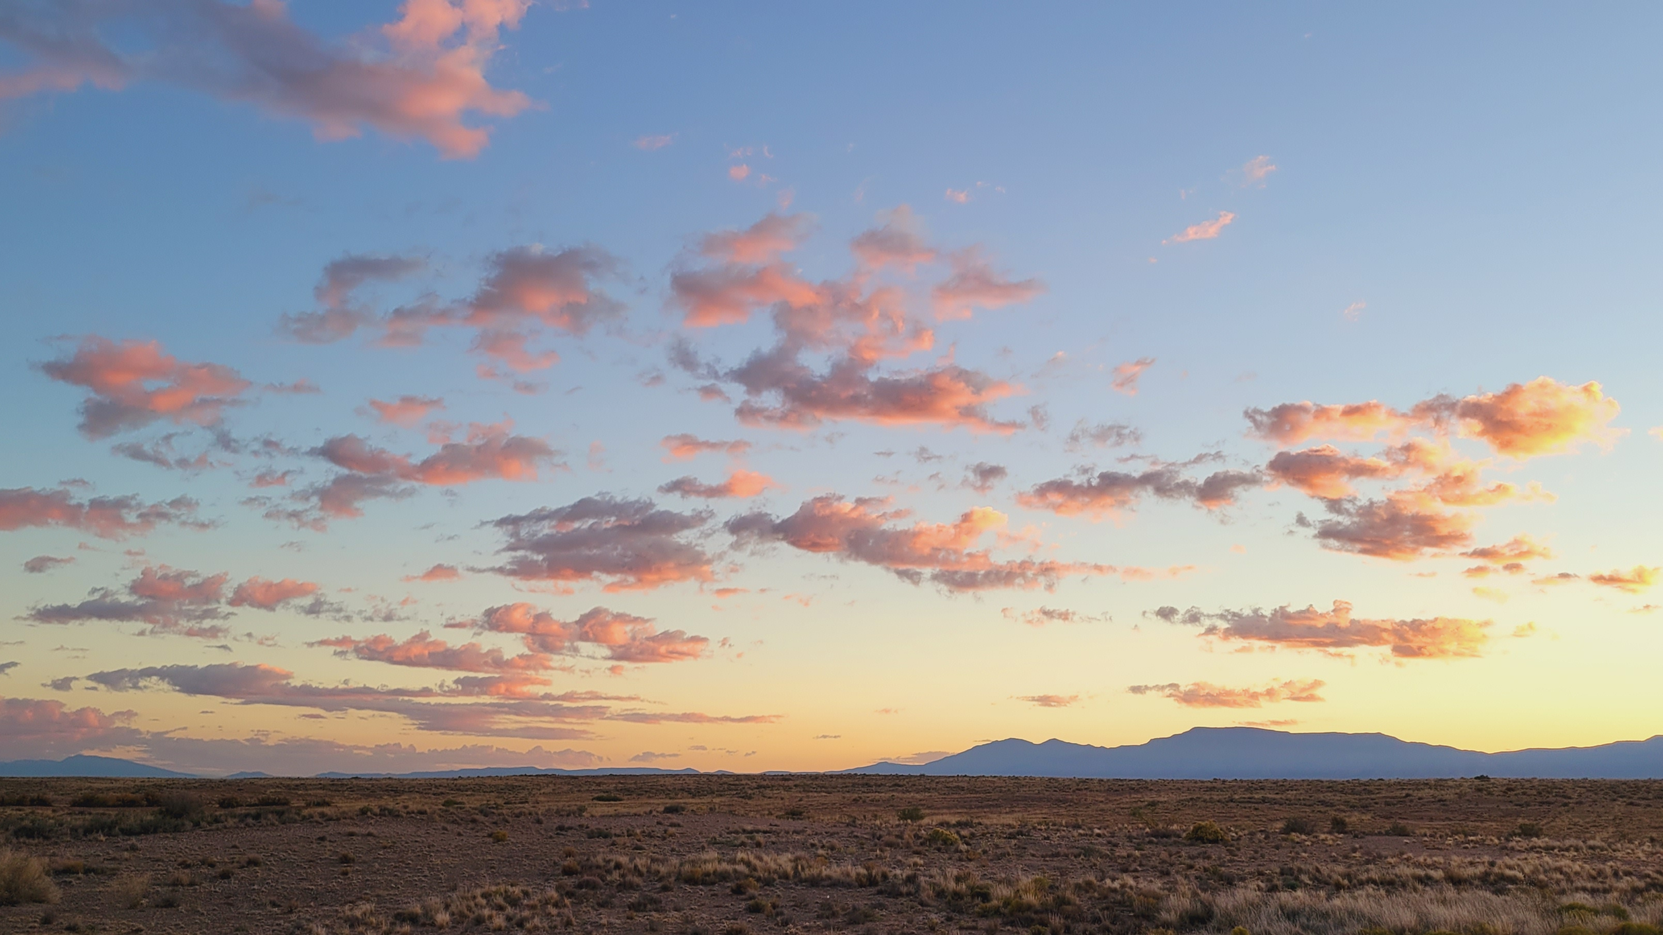
EPHESIANS 1

Slide 2
Who wrote this epistle? Who is the Author?
EPHESIANS 1

Slide 3
What is the writer’s role and how did he obtain that position?
EPHESIANS 1

Slide 4
Who were the recipients?
EPHESIANS 1

Slide 5
Which other Scriptures refer to these recipients?
EPHESIANS 1

Slide 6
Which New Testament book most closely parallels this one?
EPHESIANS 1

Slide 7
What has the blessed God blessed His people with?
EPHESIANS 1

Slide 8
In whom are these blessings found?
EPHESIANS 1

Slide 9
Wherein did God choose us?
EPHESIANS 1

Slide 10
When did God make His choice?
EPHESIANS 1

Slide 11
What is God’s intent for His chosen?
EPHESIANS 1

Slide 12
How do we become God’s sons?
EPHESIANS 1

Slide 13
With what does adoption accord?
EPHESIANS 1

Slide 14
As a result of the adoption, what happens to God and what happens to the elect?
EPHESIANS 1

Slide 15
Define “redemption.”
EPHESIANS 1

Slide 16
What is the cost of redemption for the elect?
EPHESIANS 1

Slide 17
How have “the riches of His grace” been “made to abound toward us?”
EPHESIANS 1

Slide 18
What has been “made known?”
EPHESIANS 1

Slide 19
When did the mystery unfold?
EPHESIANS 1

Slide 20
In the “fullness of times,” what is God accomplishing?
EPHESIANS 1

Slide 21
Discuss the “inheritance.”
EPHESIANS 1

Slide 22
With what does predestination accord?
EPHESIANS 1

Slide 23
Who “trusted in Christ?”
EPHESIANS 1

Slide 24
What preceded believing?
EPHESIANS 1

Slide 25
What became of those who believed?
EPHESIANS 1

Slide 26
What is the Holy Spirit doing for the believer’s inheritance?
EPHESIANS 1

Slide 27
Reconcile these phrases: “We have redemption” (7) and ”until the redemption” (14).
EPHESIANS 1

Slide 28
Whose “possession” are we?
EPHESIANS 1

Slide 29
Why did Paul give thanks?
EPHESIANS 1

Slide 30
What requests did he petition God for on their behalf?
EPHESIANS 1

Slide 31
What “mighty power” has God “worked in Christ?”
EPHESIANS 1

Slide 32
How is the church depicted in relation to Christ?
EPHESIANS 1

