Slide 1
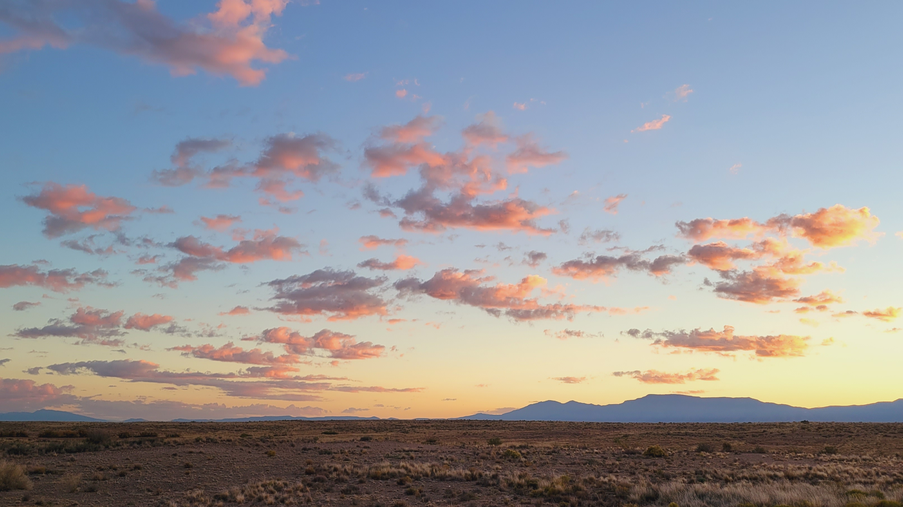
EPHESIANS 2

Slide 2
Describe our prior condition.
EPHESIANS 2

Slide 3
How were we walking at that time?
EPHESIANS 2

Slide 4
Although we were dead in sin, what did God do with us?
EPHESIANS 2

Slide 5
How does God revive dead sinners?
EPHESIANS 2

Slide 6
What are the implications of having been “raised?”
EPHESIANS 2

Slide 7
What seating arrangement has God affected?
EPHESIANS 2

Slide 8
What awaits us “in the ages to come?”
EPHESIANS 2

Slide 9
Whereby does one receive grace?
EPHESIANS 2

Slide 10
What is the fundamental nature of saving grace?
EPHESIANS 2

Slide 11
Who created us?
EPHESIANS 2

Slide 12
Why were we created?
EPHESIANS 2

Slide 13
What was the condition of the Gentiles before entering into Christ?
EPHESIANS 2

Slide 14
What has bridged the gap between Jews and Gentiles?
EPHESIANS 2

Slide 15
Identify the enmity” that separated Jews from Gentiles.
EPHESIANS 2

Slide 16
Through whom and by whom do we get to the Father?
EPHESIANS 2

Slide 17
What have the “strangers and foreigners” become?
EPHESIANS 2

Slide 18
What is the house of God built upon?
EPHESIANS 2

Slide 19
What is the building growing into?
EPHESIANS 2

