Slide 1
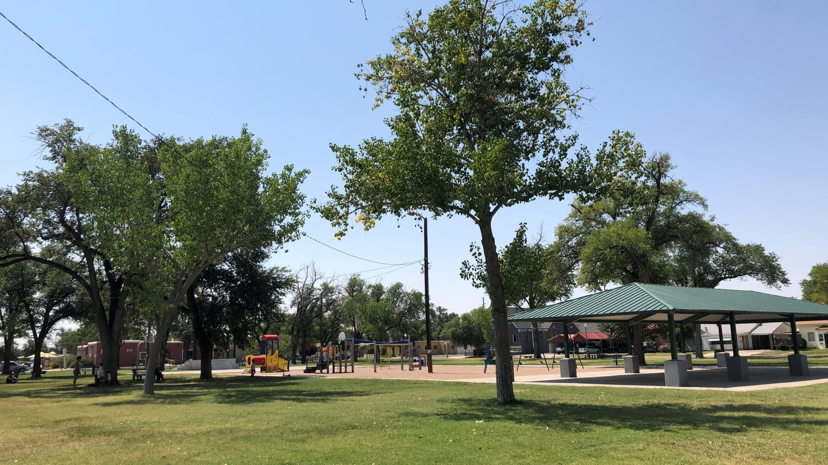
For A Successful Tent Meeting

Slide 2
For A Successful Tent Meeting
PRAY
Luke 10:1-2
Ephesians 6:18-20; Colossians 4:2-4; 2nd Thessalonians 3:1

Slide 3
For A Successful Tent Meeting
INVITE
John 1:43-46
John 4:28-29
Acts 10:24-33

Slide 4
For A Successful Tent Meeting
ASSIST
Ephesians 4:11-16
Acts 13:5
Nehemiah 8:1-4

Slide 5
For A Successful Tent Meeting
ATTEND
John 20:24-29
Luke 14:15-24

Slide 6
For A Successful Tent Meeting
APPLY
James 1:22; 4:17; Romans 2:13; Luke 6:46-48
Matthew 23:1-4; Romans 2:21-22; 1st Corinthians 9:27

