Slide 1
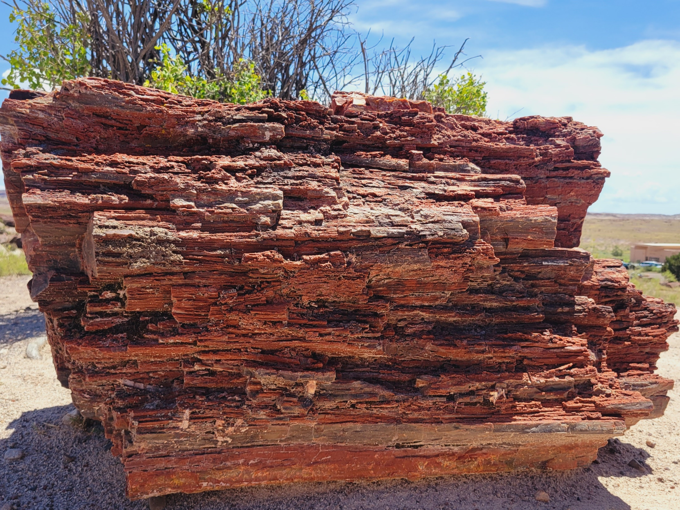
“From Heaven or From Men?”

Slide 2
“From Heaven or From Men?”
Matthew 21:23-27

Slide 3
“From Heaven or From Men?”
Intellectualism
1st Timothy 6:20-21
1st Corinthians 1:18-25; 2:1-6; 3:18-19

Slide 4
“From Heaven or From Men?”
Conscience
Titus 1:15
Acts 23:1; 24:16; 26:9
1st Corinthians 4:4
2nd Corinthians 10:12
Proverbs 14:12

Slide 5
“From Heaven or From Men?”
Conscience
Jeremiah 10:23
Jeremiah 17:9
Proverbs 3:5
Isaiah 55:8-9

Slide 6
“From Heaven or From Men?”
Majority
1st Peter 3:18-20; 2nd Peter 2:5
Luke 13:23-27; Matthew 7:13-14

Slide 7
“From Heaven or From Men?”
Parents
Ephesians 6:1
Matthew 10:37
Galatians 1:13-14
Ezekiel 18:1-20

Slide 8
“From Heaven or From Men?”
Tradition
Matthew 15:1-9
Colossians 2:8
1st Peter 1:17-19

