Slide 1
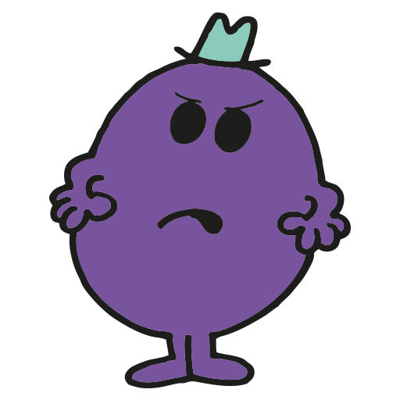
GRUMBLING

Slide 2
Introduction
Philippians 2:14-16
1st Corinthians 10:6-11
Jude 14-16

Slide 3
Grumbling Expresses Discontent
Philippians 4:10-13
1st Timothy 6:6-10
Hebrews 13:5-6

Slide 4
Grumbling Expresses Ingratitude
Colossians 3:15
1st Thessalonians 5:18
Hebrews 13:15

Slide 5
Grumbling Expresses Anxiety
Philippians 4:6-8
Matthew 6:25-34
Psalm 94:19

Slide 6
Grumbling Disregards Hope
Romans 5:1-5
Romans 8:24
James 5:7-11

