Slide 1
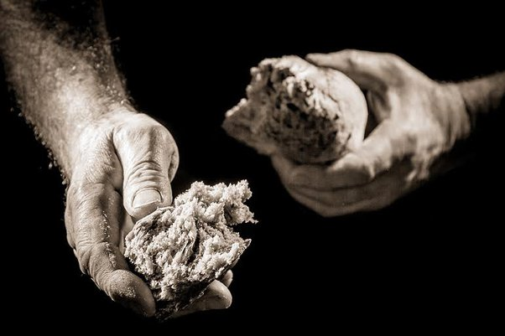
“I KNOW YOUR WORKS”
MINISTERING TO THE SAINTS

Slide 2
“I KNOW YOUR WORKS”
MINISTERING TO THE SAINTS
Introduction
Hebrews 12:22-24
Revelation 2:8-9
2nd Corinthians 9:1

Slide 3
“I KNOW YOUR WORKS”
MINISTERING TO THE SAINTS
Only Saints Are Eligible for Relief by the Church
Romans 15:25-27
Acts 2:44-45; 4:32-37

Slide 4
“I KNOW YOUR WORKS”
MINISTERING TO THE SAINTS
Need Is the Only Cause for Assistance
2nd Corinthians 9:12
1st Timothy 6:8

Slide 5
“I KNOW YOUR WORKS”
MINISTERING TO THE SAINTS
Widows Constitute a Specific Class Worthy of Enrollment
Acts 6:1-7
1st Timothy 5:3-16

Slide 6
“I KNOW YOUR WORKS”
MINISTERING TO THE SAINTS
Churches Must Collect Funds for this Purpose
2nd Corinthians 9:1-7
1st Corinthians 16:1-3

Slide 7
“I KNOW YOUR WORKS”
MINISTERING TO THE SAINTS
Churches May Cooperate in this Matter
Acts 11:27-30
2nd Corinthians 8:1-9:15

