Slide 1
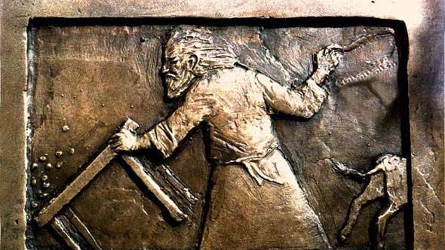
“I KNOW YOUR WORKS”
UNAUTHORIZED ACTIONS

Slide 2
“I KNOW YOUR WORKS”
UNAUTHORIZED ACTIONS
Introduction
Revelation 3:1
1st Corinthians 4:6

Slide 3
“I KNOW YOUR WORKS”
UNAUTHORIZED ACTIONS
Individual Responsibilities
1st Corinthians 12:14
Matthew 18:15-17; Acts 5:4; 1st Timothy 5:16

Slide 4
“I KNOW YOUR WORKS”
UNAUTHORIZED ACTIONS
Domestic Affairs
Matthew 19:3-6
Ephesians 6:4; Titus 2:4

Slide 5
“I KNOW YOUR WORKS”
UNAUTHORIZED ACTIONS
Politics
Romans 13:1
Matthew 22:21
John 18:36

Slide 6
“I KNOW YOUR WORKS”
UNAUTHORIZED ACTIONS
Commerce
John 2:15-17
Mark 11:15-17

Slide 7
“I KNOW YOUR WORKS”
UNAUTHORIZED ACTIONS
Entertainment
Romans 14:17
1st Corinthians 11:20-22,34
Acts 2:46

Slide 8
“I KNOW YOUR WORKS”
UNAUTHORIZED ACTIONS
External Poverty Relief
John 12:8
Psalm 37:25

Slide 9
“I KNOW YOUR WORKS”
UNAUTHORIZED ACTIONS
Conclusion
2nd John 9
Revelation 22:18-19

