Slide 1
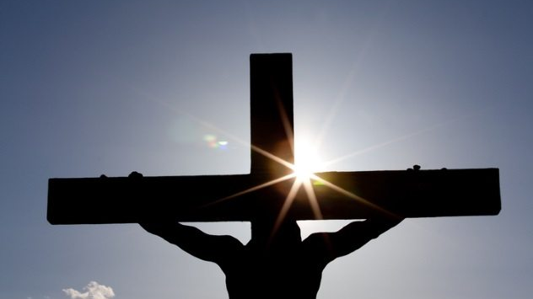
“IT IS NO LONGER I WHO LIVE”

Slide 2
“IT IS NO LONGER I WHO LIVE”
Introduction
Galatians 2:20
Galatians 6:14

Slide 3
“I Have Been Crucified with Christ”
Colossians 2:12
Romans 6:3-6

Slide 4
“It Is No Longer I Who Live”
Galatians 5:16-25
Romans 8:13
Colossians 3:5-10

Slide 5
“Christ Lives in Me”
Colossians 3:3
Colossians 2:9-10
Romans 14:8
2nd Corinthians 5:15

Slide 6
“I Live by Faith”
2nd Corinthians 5:7; Hebrews 11:1
1st Peter 1:6-9

