Slide 1
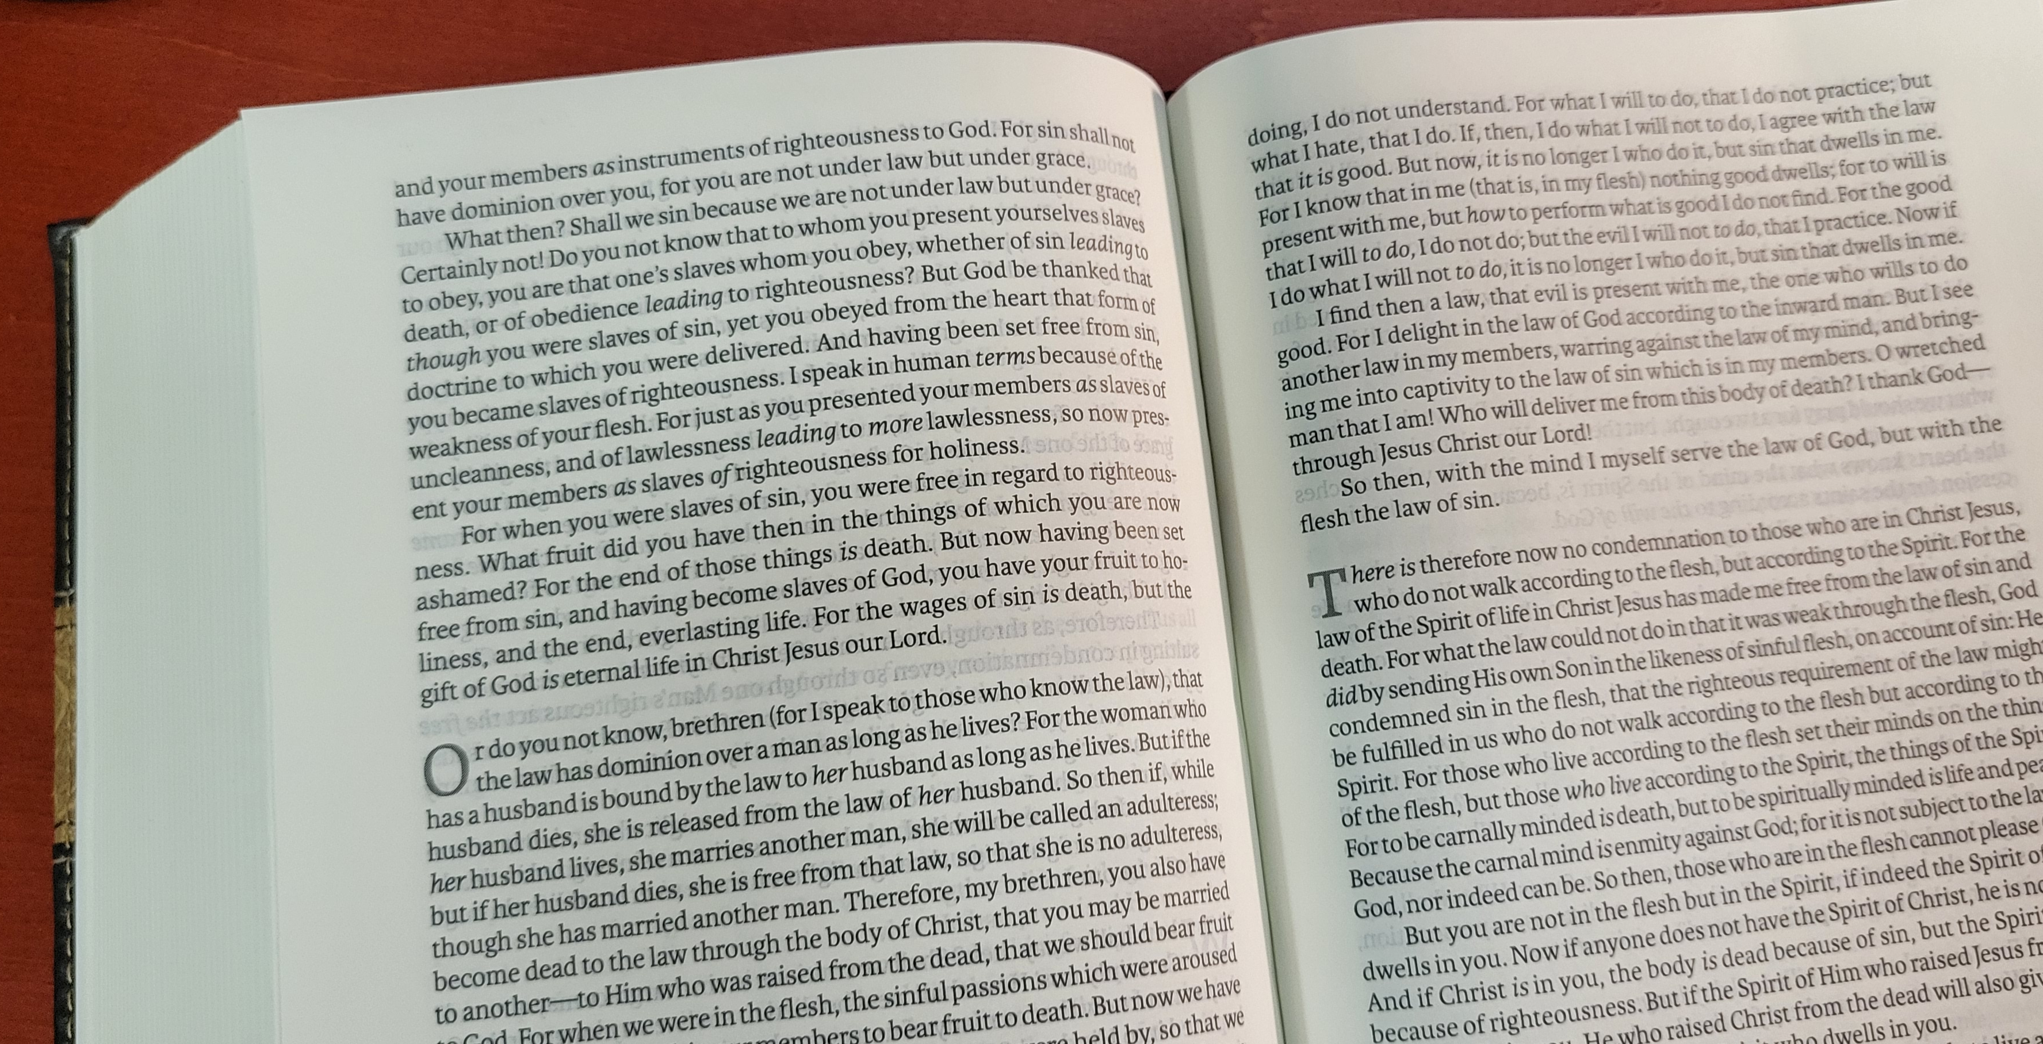
Romans 6

Slide 2


Slide 3

TAUGHT WRONG,
but
BAPTIZED RIGHT?

Slide 4
TAUGHT WRONG,
but
BAPTIZED RIGHT?
Introduction
  John 6:45
  Romans 6:1-6, 17

Slide 5
TAUGHT WRONG,
but
BAPTIZED RIGHT?
Sprinkled, Not Immersed?
  John 3:23
  Acts 8:38; Matthew 3:16
  Colossians 2:12; Romans 6:4

Slide 6
TAUGHT WRONG,
but
BAPTIZED RIGHT?
Saved, then Baptized?
  Mark 16:16; 1st Peter 3:21
  Acts 2:38; 22:16

Slide 7
TAUGHT WRONG,
but
BAPTIZED RIGHT?
Confessed Sins Instead of Christ?
  Acts 2:37
  Romans 10:9-10
  James 5:16; 1st John 1:9

Slide 8
TAUGHT WRONG,
but
BAPTIZED RIGHT?
Baptized with the Holy Spirit?
  Hebrews 6:1-2
  Acts 11:15-16
  Acts 10:44-48

Slide 9
TAUGHT WRONG,
but
BAPTIZED RIGHT?
Baptized Outside the Body?
  Ephesians 4:4; 5:23
  Colossians 1:18, 24
  1st Corinthians 12:13; Galatians 3:27

Slide 10
TAUGHT WRONG,
but
BAPTIZED RIGHT?
Conclusion
  Romans 6:17
  Acts 19:1-5

