Slide 1
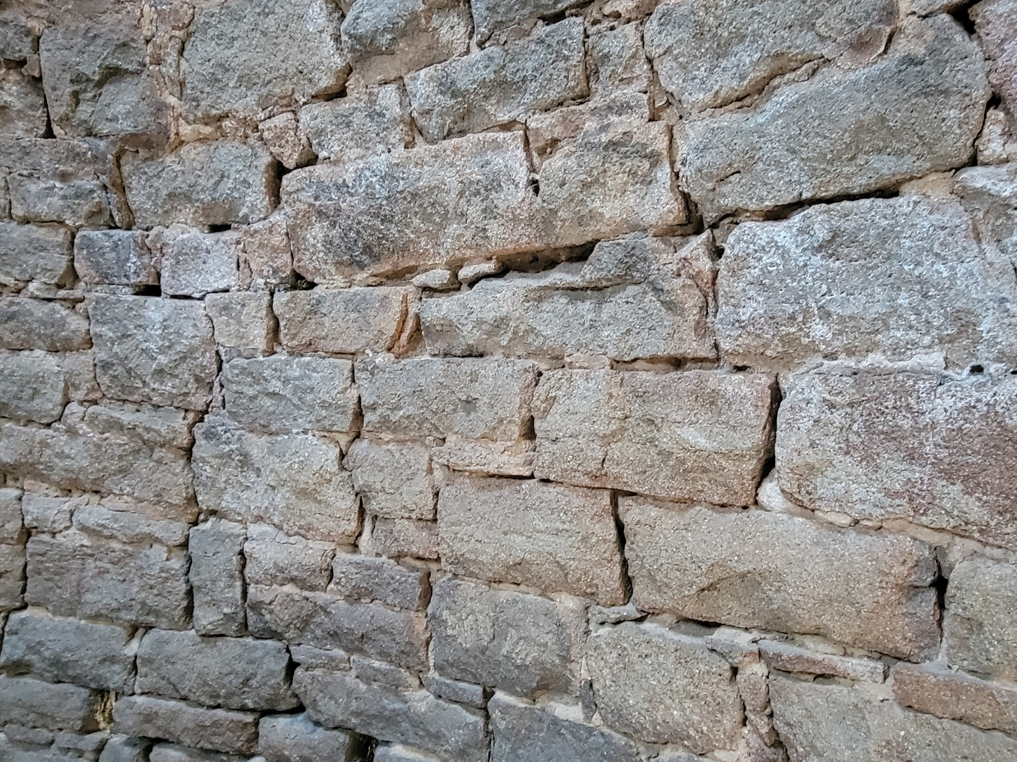
THE Prophesied Church

Slide 2
Isaiah Foretold of this Church
Isaiah 2:2-3
Hebrews 1:1-2
Acts 2:16-18
1st Timothy 3:15
Zechariah 8:3
Zechariah 1:16

Slide 3
Daniel Foretold of this Church
Daniel 2:26-45
Luke 2:1; 3:1; Acts 11:28

Slide 4
Jesus Foretold of this Church
Matthew 16:13-18
Mark 1:14-15
Mark 9:1
Acts 1:1-12
Luke 24:44-53

Slide 5
The Prophecies were Fulfilled
Acts 2:1-39
Where? (5)
How? (1-4,33)
Who? (5-12)
What? (36-38)
Acts 2:41, 47

