Slide 1
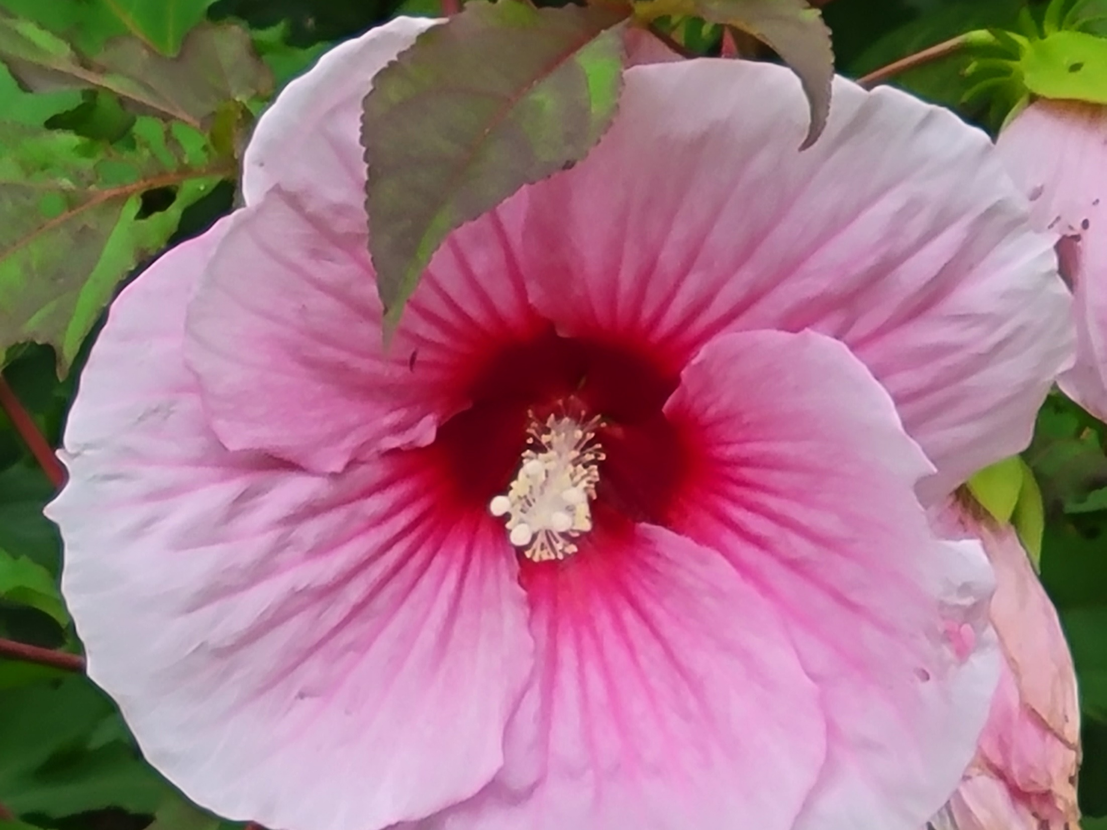
The Sum of Peace
Introduction
John 14:27; 16:33
Ephesians 2:1-18

Slide 2
The Sum of Peace
Subtract Our Trespasses
Ephesians 2:1
Romans 5:15-17
Romans 4:23-25

Slide 3
- Our Trespasses
- Our Sins

Slide 4
The Sum of Peace
Subtract Our Sins
Ephesians 2:1
James 4:17
1st John 3:4
1st John 5:17

Slide 5
- Our Trespasses
- Our Sins
- Our Lusts of the Flesh

Slide 6
The Sum of Peace
Subtract Our Lusts of the Flesh
Ephesians 2:3
1st John 2:16
Galatians 5:24; 1st Peter 4:1-2
Galatians 5:16; Romans 13:14

Slide 7
- Our Trespasses
- Our Sins
- Our Lusts of the Flesh
+ God’s Mercy

Slide 8
The Sum of Peace
Add God’s Mercy
Ephesians 2:4
James 2:13
Hebrews 4:16

Slide 9
- Our Trespasses
- Our Sins
- Our Lusts of the Flesh
+ God’s Mercy
+ God’s Love

Slide 10
The Sum of Peace
Add God’s Love
Ephesians 2:4
Romans 8:35-39
Romans 5:8; 1st John 3:16; 4:9-10
1st John 4:8, 16

Slide 11
- Our Trespasses
- Our Sins
- Our Lusts of the Flesh
+ God’s Mercy
+ God’s Love
+ God’s Grace

Slide 12
The Sum of Peace
Add God’s Grace
Ephesians 2:5, 7-8
2nd Corinthians 8:9
1st Corinthians 15:9-10; 1st Timothy 1:12-16
Titus 2:11-13

Slide 13
- Our Trespasses
- Our Sins
- Our Lusts of the Flesh
+ God’s Mercy
+ God’s Love
+ God’s Grace
+ Our Faith

Slide 14
The Sum of Peace
Add Our Faith
Ephesians 2:8
1st Peter 1:9; Romans 5:1-2
2nd Corinthians 5:7; Hebrews 11:1
Romans 10:17
Acts 6:17

Slide 15
- Our Trespasses
- Our Sins
- Our Lusts of the Flesh
+ God’s Mercy
+ God’s Love
+ God’s Grace
+ Our Faith
- Our Works of Merit

Slide 16
The Sum of Peace
Subtract Our Works of Merit
Ephesians 2:9
2nd Timothy 1:9; Titus 3:5
Romans 11:6

Slide 17
- Our Trespasses
- Our Sins
- Our Lusts of the Flesh
+ God’s Mercy
+ God’s Love
+ God’s Grace
+ Our Faith
- Our Works of Merit
+ Our Works in Christ

Slide 18
The Sum of Peace
Add Our Works in Christ
Ephesians 2:10
James 2:14-26
Hebrews 10:24-25
1st John 3:18

Slide 19
- Our Trespasses
- Our Sins
- Our Lusts of the Flesh
+ God’s Mercy
+ God’s Love
+ God’s Grace
+ Our Faith
- Our Works of Merit
+ Our Works in Christ
+ Christ’s Blood

Slide 20
The Sum of Peace
Christ’s Blood
Ephesians 2:13
Hebrews 9:13-14, 22
1st Peter 1:18-19

Slide 21
- Our Trespasses
- Our Sins
- Our Lusts of the Flesh
+ God’s Mercy
+ God’s Love
+ God’s Grace
+ Our Faith
- Our Works of Merit
+ Our Works in Christ
+ Christ’s Blood
- Moses’s Law

Slide 22
The Sum of Peace
Subtract Moses’s Law
Ephesians 2:14-15
Hebrews 7:19; 10:1
Galatians 3:19-25; Romans 10:4

Slide 23
- Our Trespasses
- Our Sins
- Our Lusts of the Flesh
+ God’s Mercy
+ God’s Love
+ God’s Grace
+ Our Faith
- Our Works of Merit
+ Our Works in Christ
+ Christ’s Blood
- Moses’s Law
_________________________
Peace

Slide 24
The Sum of Peace
The Sum Is Peace
Ephesians 2:15-18
Isaiah 26:3
Romans 5:1

