Slide 1
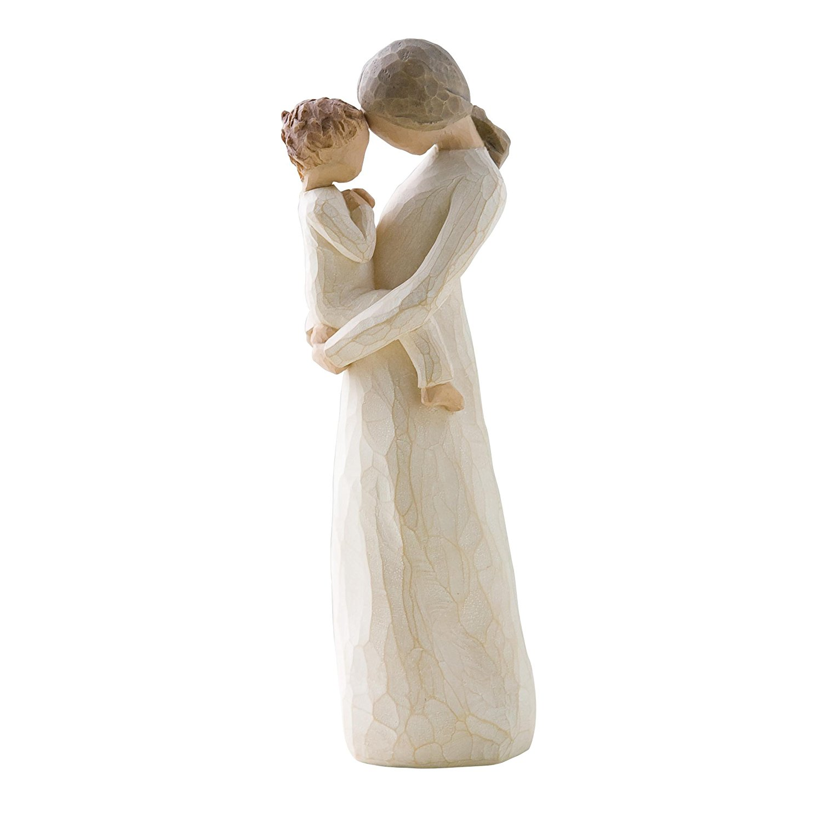
The Woman God Chose
To Raise His Son
Notes:
Writing our wills before we left for South Africa in 2015, Rachel and I had little to discuss regarding property since we own little, but the real challenge was deciding who would raise our children in the event of our mutual deaths.
Do we choose a couple from my family and potentially offend hers?
Do we choose a couple from her family and potentially offend mine?
Do we choose a couple nearby so the children don’t move far?
Do we choose a couple our age, raising children close to our kids?
What matters most is that the couple we choose are faithful Christians.
Regardless of whom we choose, no other couple is us.
Imagine, then, how it must have been for God to choose the mortal woman who would raise His only begotten Son on earth!

Slide 2
The Woman God Chose
To Raise His Son
A woman who submitted to God’s plan.
Luke 1:26-38
Notes:
Presented with great responsibility, Mary unflinchingly accepted her role. She was, of course, curious how it could happen, but she didn’t object or offer excuses. She offered herself as “the maidservant of the Lord!” and said, “Let it be according to your word”. If we mean what we say when praying, “Your will be done on earth as it is in heaven” (Matthew 6:10), we will likewise accept the work God gives us to do.

Slide 3
The Woman God Chose
To Raise His Son
A woman whose own plans were set on hold.
Matthew 2:1-18
Notes:
We cannot know exactly what Mary’s plans were at the time, but as a new mother, one may easily gather she intended to “nest” and settle into domestic life with her husband and child. Instead, the three of them fled under the cover of darkness to become refugees in a foreign land. Motherhood is a continual sacrifice, but those who are “without natural affection” (Romans 1:31 kjv) put their own preferences above the needs of the child. Some abort unwanted pregnancies, shedding innocent blood. Some pursue their educational or professional goals, leaving the little ones to be raised by nannies. Motherhood must not be about the mother, though, because motherhood is about the children.

Slide 4
The Woman God Chose
To Raise His Son
A woman who did not always understand her child.
Luke 2:41-50
Notes:
Unsurprisingly, the human mother of the Son of God didn’t always understand her boy. It’s all the more common among children who aren’t divine, especially in the adolescent years. God did not select a perfectly flawless woman for this task. She struggled some, and all moms will.

Slide 5
The Woman God Chose
To Raise His Son
A woman who kept her child in submission.
Luke 2:51-52
Notes:
Although this may be owing more to Jesus’ character than that of His parents, it remains that He grew up in a house where children honored and obeyed their mother and father (Colossians 3:20). To do otherwise would be catastrophic (Proverbs 20:20). Parents are responsible for training their offspring in the right ways of the Lord (Proverbs 22:6).

Slide 6
The Woman God Chose
To Raise His Son
A woman who trusted and encouraged her child.
John 2:1-12
Notes:
I admit I don’t fully understand the Master’s reluctance to perform this, the first of His countless miracles, but when He did so it was at the suggestion of Mary, who trusted and encouraged her Son. Children must have the opportunity to earn their parents’ trust, as parents who constantly hover over their children, never allowing them to make decisions of their own, are most likely to raise renegades who rebel at the first opportunity. There is a real danger in discouraging children (Colossians 3:21).

Slide 7
The Woman God Chose
To Raise His Son
A woman who accepted fellowship over kinship.
Luke 8:19-21; 11:27-28
John 19:25-27
Notes:
Jesus made clear to His mother and siblings that discipleship takes precedence over family. He made the same point to a random person who wished to exalt Mary the way Catholics do. Mary implicitly accepted this. In fact, as Jesus was dying He entrusted her care to His apostle John, not to his brothers. The church is family (1st Timothy 5:1-2), the most important relationship of all.

Slide 8
The Woman God Chose
To Raise His Son
A woman who kept praying.
Acts 1:9-14
Notes:
After watching her firstborn viciously slain, then risen from the dead, then ascended back to glory, Mary might have been confused or frustrated. Even though her Son was visibly in heaven, she was still bereft of her child. When Job’s children all died the same day, his wife held a terribly discouraging attitude (Job 2:9). Not Mary, though. She knew to “pray without ceasing” (1st Thessalonians 5:17).

