Slide 1
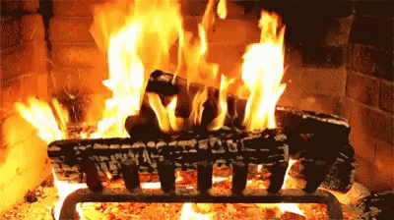

Slide 2
“WHENEVER YOU COME TOGETHER”
Introduction
1st Corinthians 14:26
Hebrews 10:23-25

Slide 3
“WHENEVER YOU COME TOGETHER”
Coming Together Affects Our Greetings
Romans 16:16; 1st Peter 5:14
Galatians 2:9
Acts 20:1

Slide 4
“WHENEVER YOU COME TOGETHER”
Coming Together Affects Our Comfort
1st Thessalonians 5:11
Romans 12:15
Acts 20:37

Slide 5
“WHENEVER YOU COME TOGETHER”
Coming Together Affects Our Music
James 5:13
Ephesians 5:19
Colossians 3:16

Slide 6
“WHENEVER YOU COME TOGETHER”
Coming Together Affects Our Prayers
Matthew 6:5-6
Acts 12:5, 12
James 5:16

Slide 7
“WHENEVER YOU COME TOGETHER”
Coming Together Affects the Lord’s Supper
Acts 20:7
1st Corinthians 11:17-33

