Slide 1
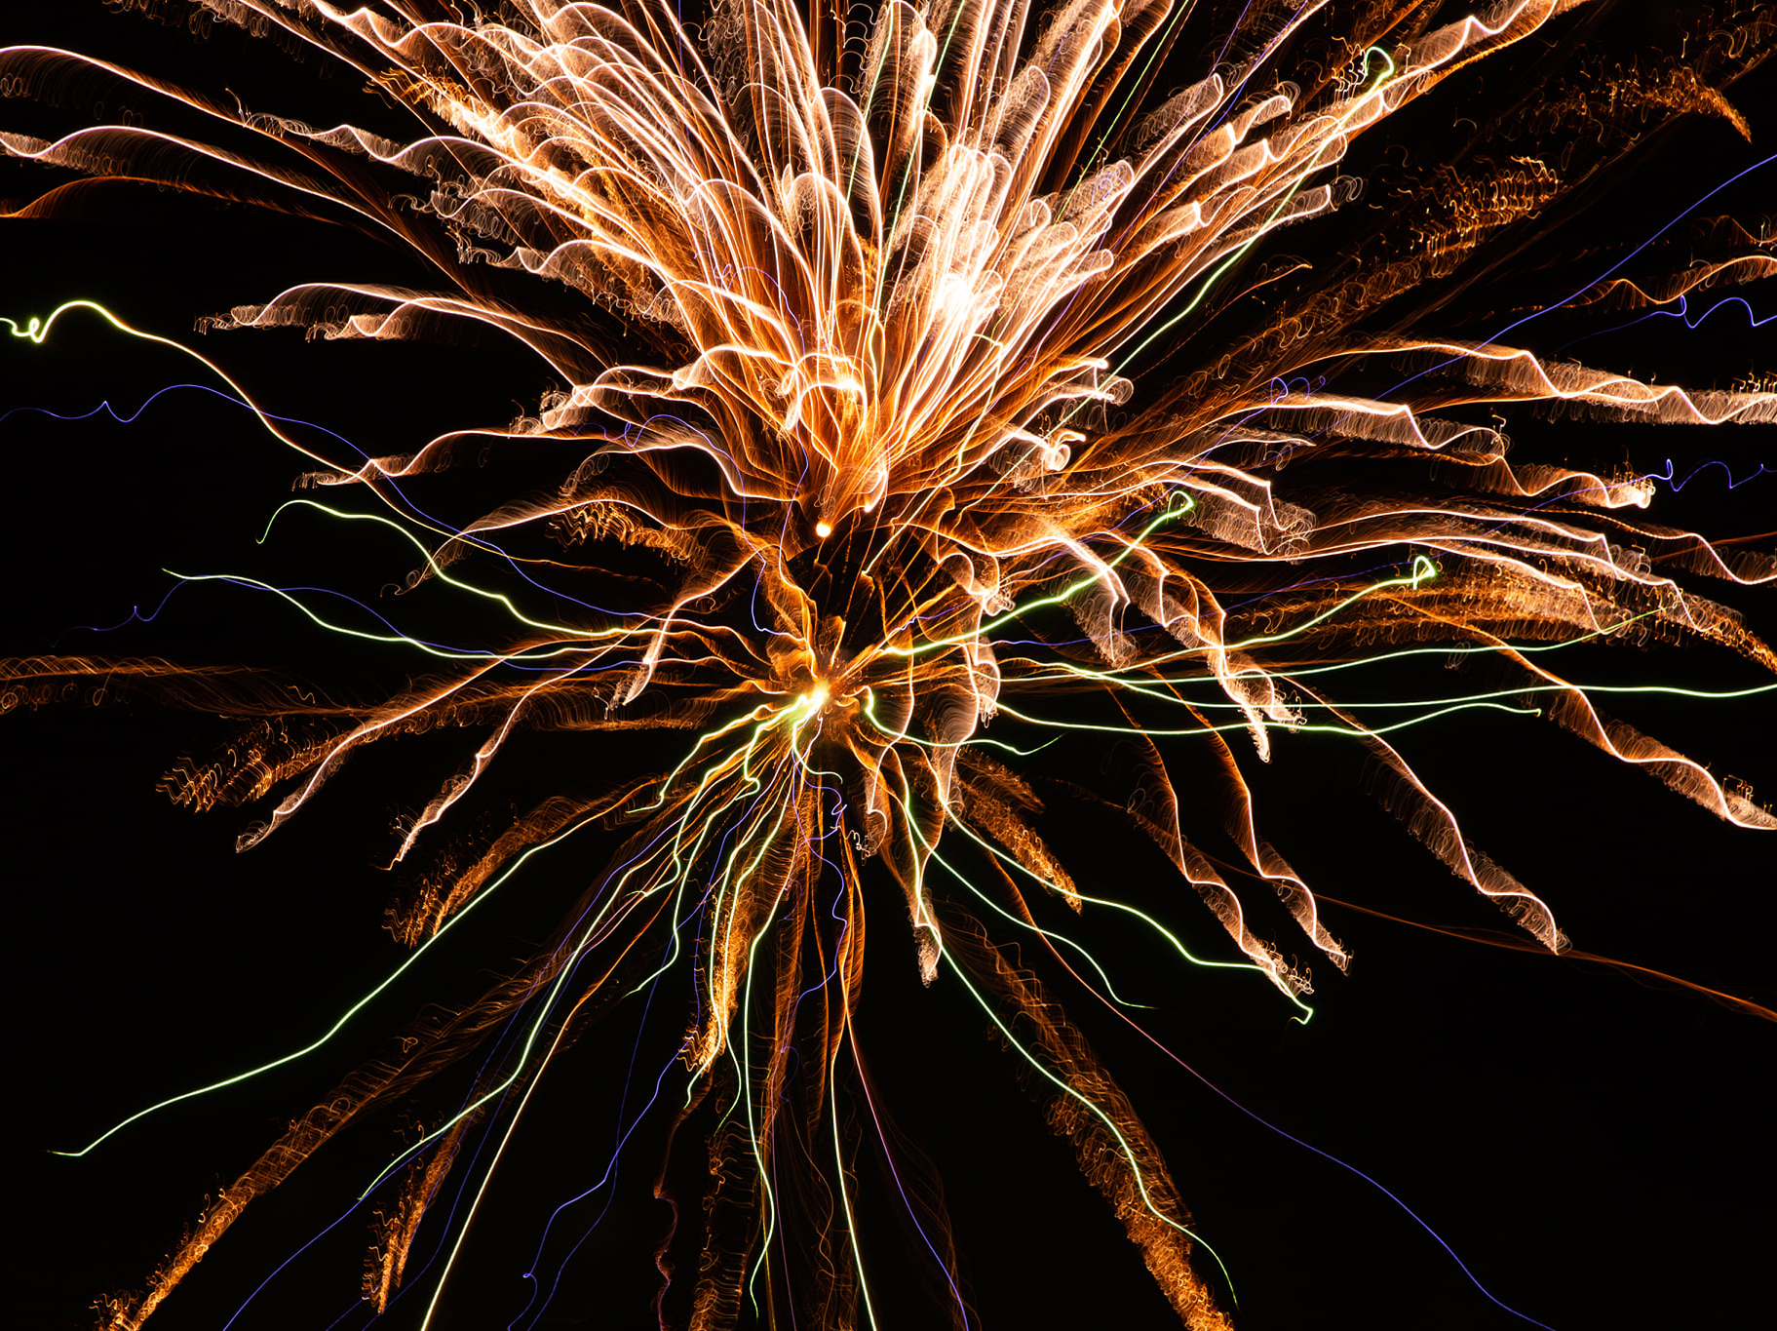
WHY I BELIEVE

Slide 2
I Believe God exists because nature reveals Him.
Hebrews 3:4
Psalm 19:1
Romans 1:20

Slide 3
I Believe God expects us to seek Him because He has instilled it in us innately to do so.
Ecclesiastes 3:11
Acts 17:26-28
Matthew 7:7

Slide 4
I Believe Jesus of Nazareth rose from the dead because eyewitnesses bore testimony to the fact.
Luke 24:44-48
Acts 2:32; 4:33; 10:40-41
1st Corinthians 15:1-8

Slide 5
I Believe Jesus is the Son of God, the Savior, & the Judge of all souls because He arose.
Romans 1:1-4
Acts 5:30-32
Acts 17:31

Slide 6
I Believe God holds souls accountable to an objective standard because He is the God of truth.
Deuteronomy 32:4
Proverbs 20:10
John 14:6; Acts 4:12
Ephesians 4:4-6

