Slide 1
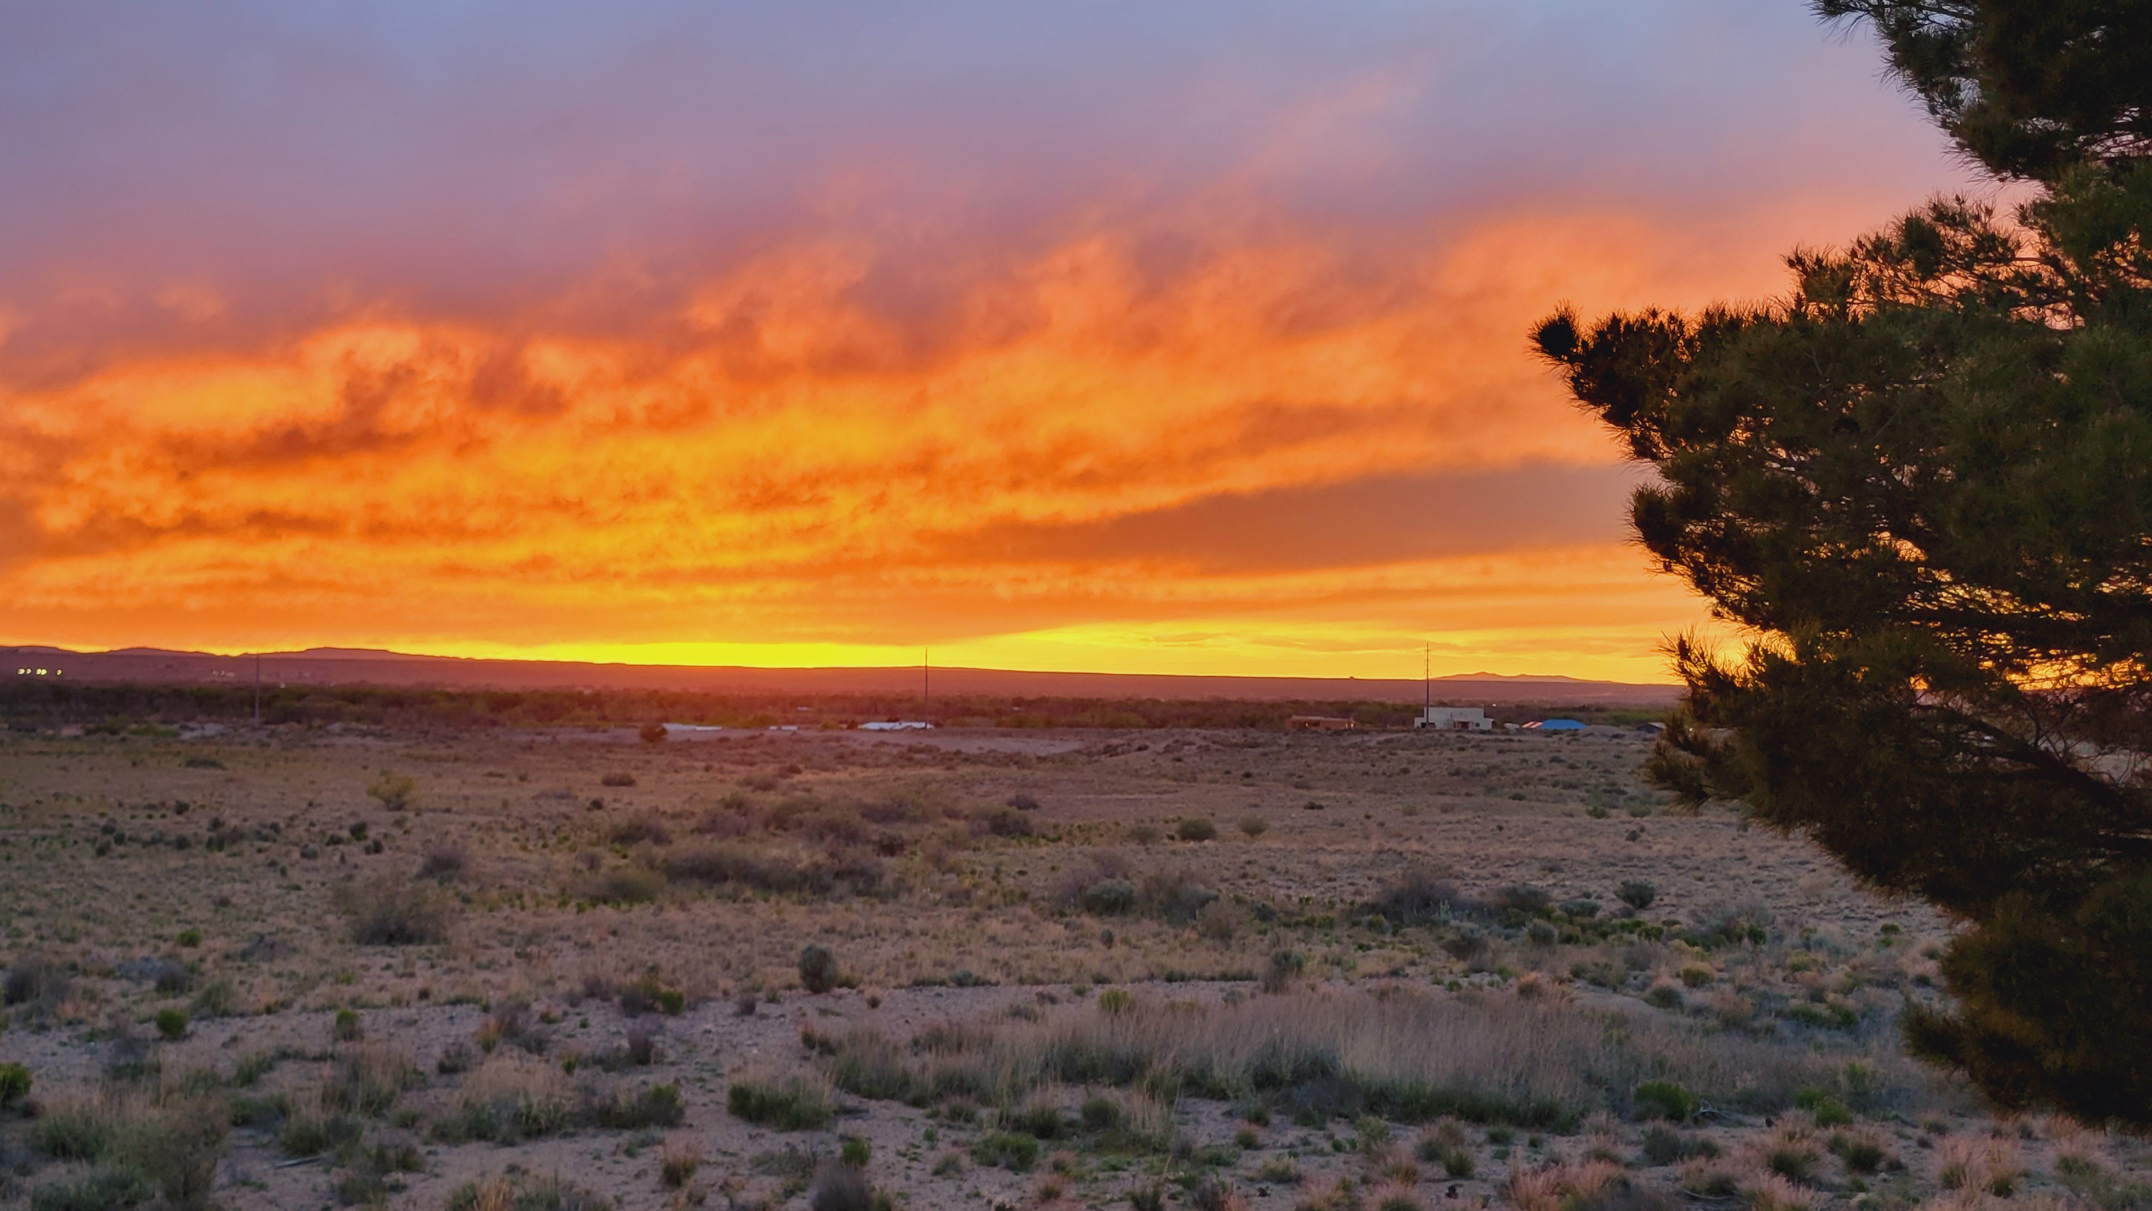
“Can Faith Save Him?”
James 2:14

Slide 2
“Can Faith Save Him?”
“What Does It Profit?”
James 2:15-17
1st John 3:17-18

Slide 3
“Can Faith Save Him?”
“Even the Demons Believe and Tremble!”
James 2:18-20
Mark 3:11-12

Slide 4
“Can Faith Save Him?”
“Was Not Abraham Our Father Justified By Works?”
James 2:21-24
Genesis 22:1-18
Hebrews 11:17-19

Slide 5
“Can Faith Save Him?”
“Likewise, Was Not Rahab the Harlot Also Justified By Works?”
James 2:25-26
Joshua 2:1-22; 6:16-25
Hebrews 11:31

Slide 6
“Can Faith Save Him?”
Conclusion
Hebrews 3:16-19
Romans 10:9-10; Mark 1:15; 16:16

