Slide 1
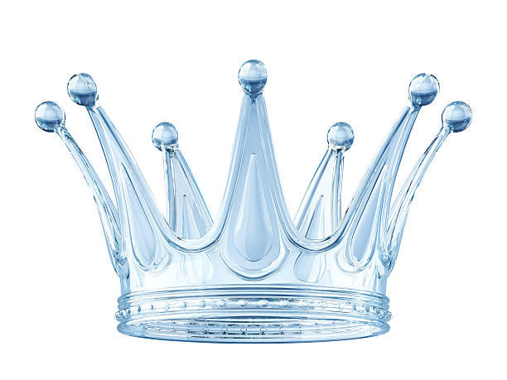
CASTING CROWNS

Slide 2
CASTING CROWNS
Revelation 4

Slide 3
CASTING CROWNS
Twenty-Four Elders Sitting Twenty-Four Thrones
Revelation 4:4_{a}
Matthew 19:28
Revelation 21:12, 14

Slide 4
CASTING CROWNS
Wearing Golden Crowns
Revelation 4:4_{b}
1st Corinthians 9:24-27
2nd Timothy 4:7-8
James 1:12
2nd Timothy 2:11-13

Slide 5
CASTING CROWNS
Offering Worship
Revelation 4:9-10_{a}
Acts 12:20-24; 10:24-26
Matthew 2:11; 8:2; 9:18; 14:33; 15:25; 28:9
Philippians 2:9-11

Slide 6
CASTING CROWNS
Surrendering Their Crowns
Revelation 4:10_{b}
1st Chronicles 29:10-12; Daniel 4:34-35; 6:25-27
1st Timothy 6:11-16; Rev. 17:14; 19:16
Luke 17:7-10

Slide 7
CASTING CROWNS
Conclusion
1st Peter 2:9-12
John 3:3-5

