Slide 1
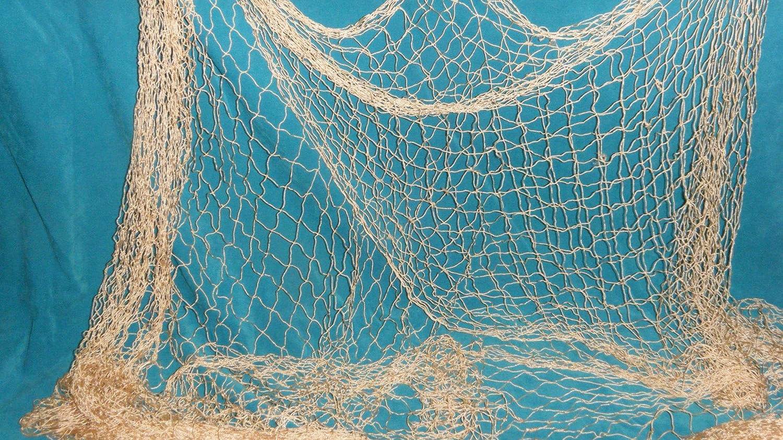
CASTING NETS

Slide 2
Fishing for Men
Mark 1:16-20
1st Corinthians 3:5-15
Proverbs 11:30
Matthew 28:19-20
CASTING NETS

Slide 3
Nets, Not Hooks
Matthew 17:27
Matthew 13:47-50
Luke 8:5-8, 11-15
Mark 4:26-27
Luke 5:1-11
CASTING NETS

Slide 4
Good Fish Will Be Separated from Bad
Matthew 13:47-50
Leviticus 11:9-12
Matthew 13:36-43
Matthew 25:32-33
CASTING NETS

