Slide 1
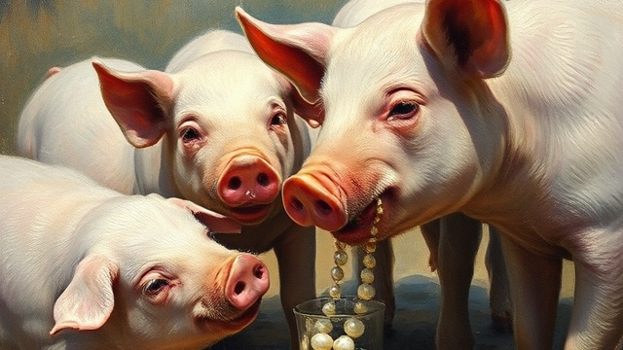
CASTING PEARLS

Slide 2
CASTING PEARLS
Introduction
Matthew 13:45-46
Matthew 7:6
Luke 9:16; 10:8-12

Slide 3
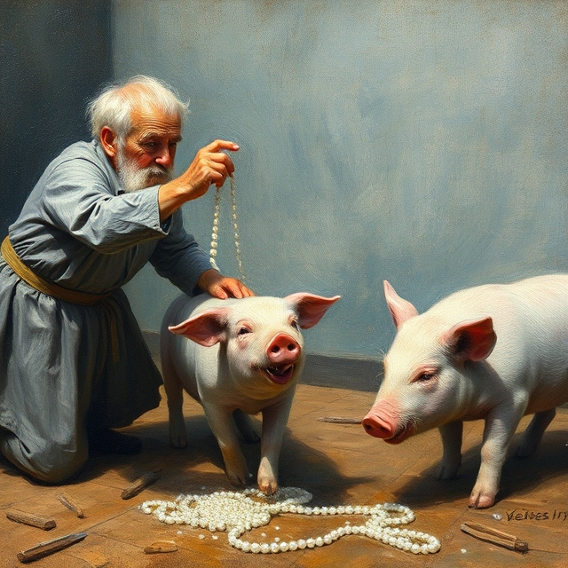
Casting Pearls
Not an Invitation to Self-Righteousness
Matthew 9:11-13
Luke 18:9-14

Slide 4
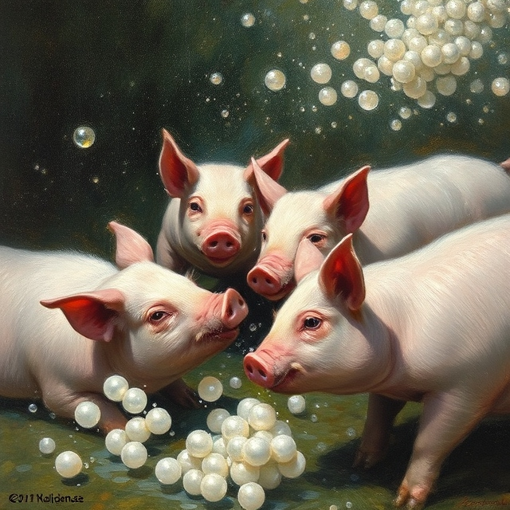
Casting Pearls
An Exercise in Discernment
Hebrews 5:12-14
John 7:24
Matthew 7:15-20

Slide 5
Casting Pearls
A Matter of Priority
Colossians 4:5
Proverbs 9:7-9
Acts 13:46-51; 18:5-6

Slide 6
Casting Pearls
Conclusion
1st Corinthians 1:18-25
Revelation 22:17

