Slide 1
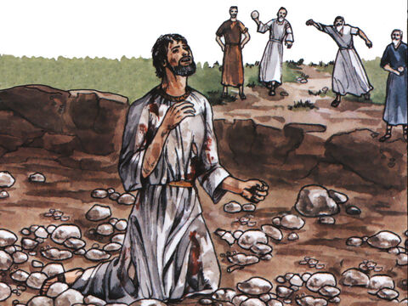
CASTING
STONES

Slide 2
Introduction
Leviticus 20:2; 24:14; Numbers 15:32-36; Deuteronomy 17:2-5; 21:18-21; Joshua 7:20-25
Romans 13:4
CASTING
STONES

Slide 3
An Adulteress Was Not Stoned
John 8:2-11
Leviticus 20:10; Deuteronomy 22:22
Deuteronomy 17:6-7
CASTING
STONES

Slide 4
Stephen Was Stoned and So Was Paul
Acts 6:8-14; 7:51-60
2nd Corinthians 11:25; Acts 14:19-20
Matthew 5:10-12; 2nd Timothy 3:12; 1st Peter 4:16
CASTING
STONES

Slide 5
Jesus Was Not Stoned
John 8:48-59; 10:22-39
Luke 4:29-30
John 6:15
John 7:1-10, 19-20, 25, 30; 8:18-20
John 10:17-18
Psalm 22:16-18; Zechariah 12:10
CASTING
STONES

