Slide 1
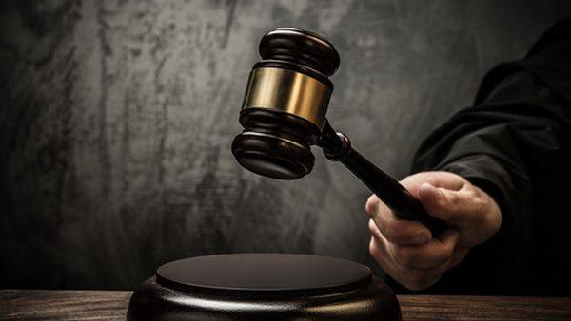
“I DID NOT COME TO JUDGE”

Slide 2
“I DID NOT COME TO JUDGE”
“I Did Not Come to Judge”
John 12:47-48
Acts 17:30-31; 10:36-42
John 3:17-21; 5:26-30

Slide 3
“I DID NOT COME TO JUDGE”
“Neither Do I Condemn You”
John 12:8:1-11
John 18:31
Leviticus 20:10; Deuteronomy 22:22
Deuteronomy 17:7

Slide 4
“I DID NOT COME TO JUDGE”
“Judge with Righteous Judgment”
John 7:24; 1st Samuel 16:7
Matthew 7:1-5; Romans 2:1-4
1st Corinthians 6:1-8; Jude 14-15; Matthew 12:41-42
Philippians 1:9; Hebrews 5:12-14

