Slide 1
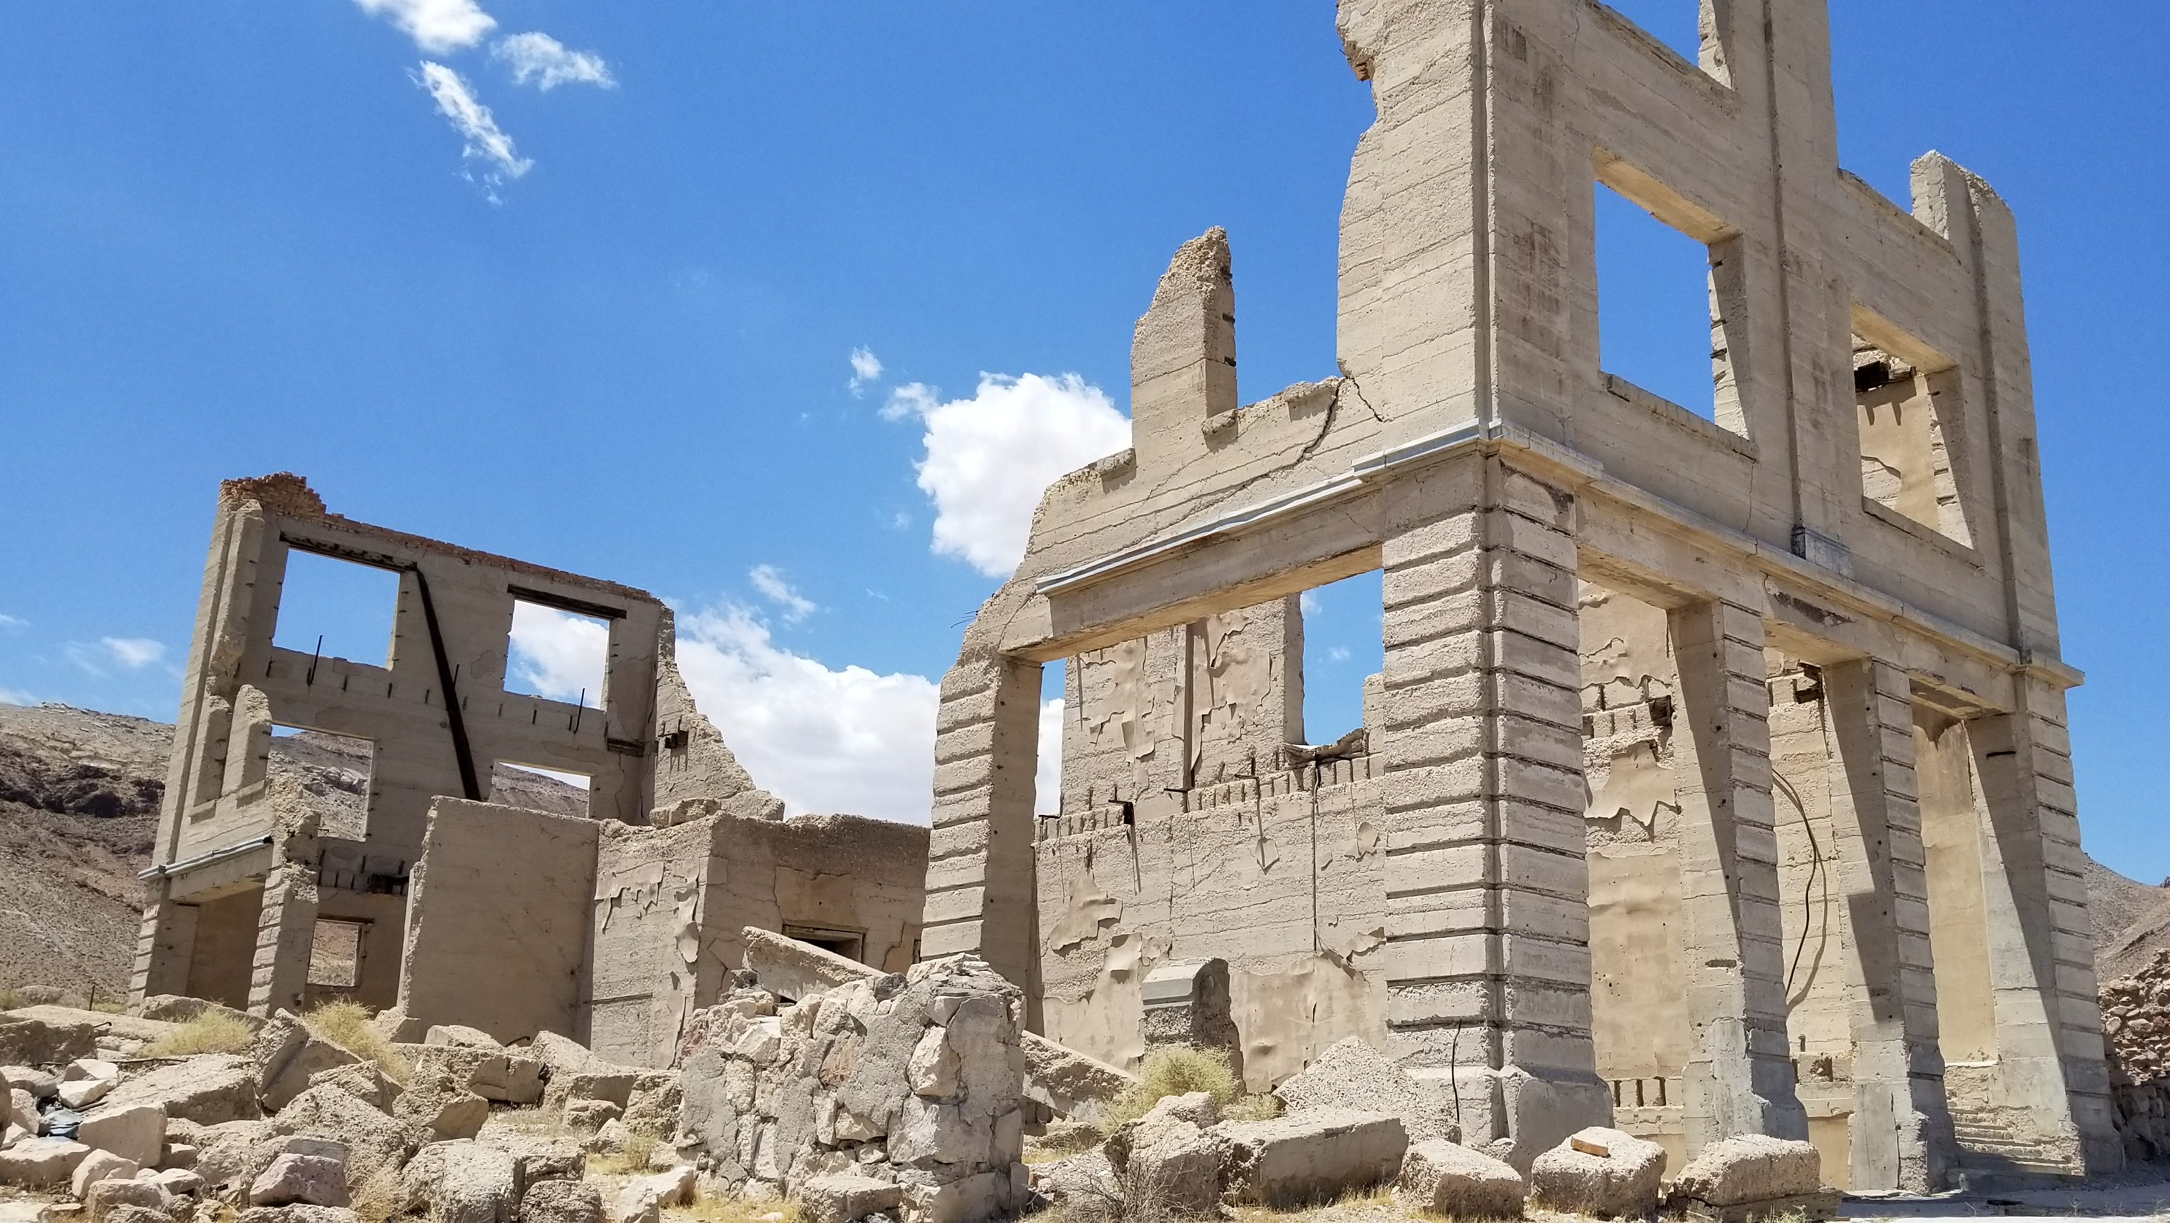
“Rise Up and Build”

Slide 2
“Rise Up and Build”
Introduction
Nehemiah 2:17-18
1st Corinthians 3:9-17

Slide 3
“Rise Up and Build”
Spirits Were Stirred
Ezra 1:1-5; Haggai 1:1-15
Acts 17:16-17

Slide 4
“Rise Up and Build”
Hands Were Set
Nehemiah 2:18
Ezra 4:4-5; Nehemiah 6:1-9
Hebrews 12:12

Slide 5
“Rise Up and Build”
Offerings Were Given
Ezra 2:68-69; 7:12-20
Romans 12:6-8

Slide 6
“Rise Up and Build”
People Were United
Ezra 3:1-2; Nehemiah 8:1-3
Acts 4:32; 1st Corinthians 1:10

Slide 7
“Rise Up and Build”
What Is Written Was Followed
Ezra 3:1-2, 4; 6:18; Nehemiah 6:18; 10:34, 36
Acts 7:44; Philippians 3:17

Slide 8
“Rise Up and Build”
Separation Was Committed To
Ezra 9:1-10:4; Nehemiah 9:1-2
2nd Corinthians 6:14-18

