Slide 1
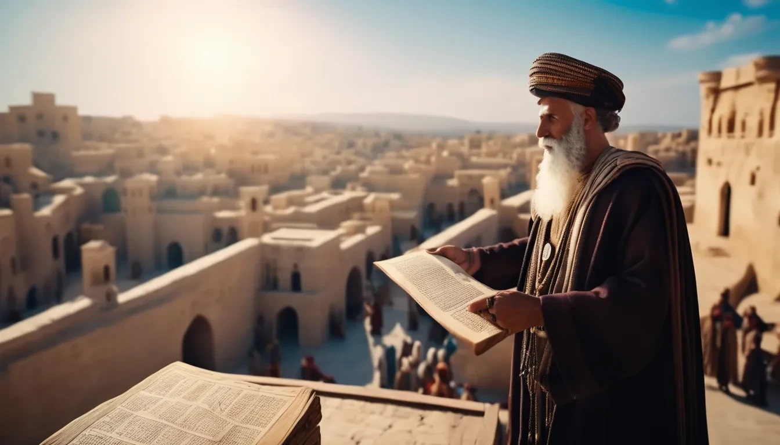
“The People Gathered Together as One Man”
Nehemiah 8:1-12

Slide 2
“They Told Ezra to Bring the Book”
Nehemiah 8:1-2
Acts 10:33

Slide 3
“From Morning Until Midday”
Nehemiah 8:3_{a}
Acts 20:7

Slide 4
“The Ears of All the People Were Attentive”
Nehemiah 8:3_{b}
Matthew 13:23

Slide 5
“Ezra Stood on a Platform… Which They had Made for the Purpose”
Nehemiah 8:4-5_{a}
2nd Kings 4:8-10

Slide 6
“All the People Stood Up”
Nehemiah 8:5_{b}-6
1st Kings 8:12-14; 2nd Chronicles 34:29-32

Slide 7
“All the People Answered, ‘Amen, Amen!’”
Nehemiah 8:6
Deuteronomy 27:16-26
1st Corinthians 14:16

Slide 8
“They Gave the Sense and Helped them to Understand”
Nehemiah 8:7-8
Ephesians 5:17
Acts 8:30-31

Slide 9
“All the People Wept When They Heard the Word”
Nehemiah 8:9
2nd Kings 22:11
2nd Corinthians 7:11

