Slide 1
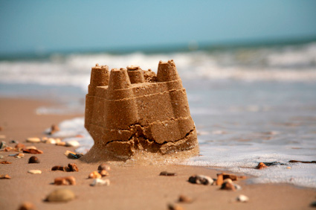
BUILT ON SAND

Slide 2
BUILT ON SAND
Introduction
Hebrews 12:25-28
Matthew 7:24-27

Slide 3
BUILT ON SAND
False Prophecy
“But bear in mind that the end of 1914 is not the date for the beginning, but for the end of the time of trouble.”
--Zion's Watch Tower, July 15th 1894, page 226

Slide 4
BUILT ON SAND
False Prophecy
Deuteronomy 18:20-22
Zechariah 13:1-3; 1st Corinthians 13:8-13
1st Thessalonians 5:2; 2nd Peter 3:10

Slide 5
False Hope of Heaven
“So rather than all good people going to heaven, the Bible reveals that only 144,000 tried and faithful persons will be taken there to rule with Christ.”
--You Can Live Forever in Paradise on Earth, Copyright 1982 by Watch Tower Bible and Tract Society, Page 124
BUILT ON SAND

Slide 6
BUILT ON SAND
False Hope of Heaven
Ephesians 4:4
Matthew 20:1-16
Colossians 1:3-6
Revelation 14:1-5

Slide 7
BUILT ON SAND
False Hope of Earth
“Even persons now dead will enjoy the paradise earth.”
--You Can Live Forever in Paradise on Earth, Copyright 1982 by Watch Tower Bible and Tract Society, Page 165

Slide 8
BUILT ON SAND
False Hope of Earth
Romans 8:24
2nd Peter 3:10-13
1st Corinthians 15:50-54; 2nd Corinthians 5:1-8; 1st Thessalonians 4:13-18

Slide 9
False Hope of Hell
“Hell could not be a place of torment because such an idea never came into the mind or heart of God. Additionally, to torment a person eternally because he did wrong on earth for a few years is contrary to justice.”
--You Can Live Forever in Paradise on Earth, Copyright 1982 by Watch Tower Bible and Tract Society, Page 89
BUILT ON SAND

Slide 10
BUILT ON SAND
False Hope of Hell
Romans 11:22; Hebrews 10:26-31
Matthew 13:41-42, 49-50
Mark 9:43-48
Matthew 25:31-46; 2nd Thessalonians 1:6-10

Slide 11
Denial of Christ’s Deity
“Well, did Jesus ever say that he was God? No, he never did. Rather, in the Bible he is called ‘God’s Son.’”
--You Can Live Forever in Paradise on Earth, Copyright 1982 by Watch Tower Bible and Tract Society, Page 39
BUILT ON SAND

Slide 12
BUILT ON SAND
Denial of Christ’s Deity
John 1:1
Colossians 2:9
Hebrews 1:3, 8, 10; Psalm 102:1, 25-27
1st John 2:23

Slide 13
Confusion about Blood
“Jehovah’s Witnesses are well known for taking these Bible commands to heart. They reject all transfusions involving whole blood or the four primary blood components—red cells, plasma, white cells, and platelets.”
--The Real Value of Blood, Awake!—2006, page 10, http://wol.jw.org/en/wol/d/r1/lp-e/102006283
BUILT ON SAND

Slide 14
BUILT ON SAND
Confusion about Blood
Genesis 9:4
Leviticus 3:17
Acts 15:19-20, 28-29, 21:25

Slide 15
Distraction over Names
“Likewise, it is proper to use God’s name, which is revealed in the Bible, whether we pronounce it ‘Yah-weh,’ ‘Jehovah,’ or in some other way common in our language. What is wrong is to fail to use that name.”
----You Can Live Forever in Paradise on Earth, Copyright 1982 by Watch Tower Bible and Tract Society, Page 44
BUILT ON SAND

Slide 16
Distraction over Names
Ex. 3:13-15; 6:2-3; 34:14
Acts 4:10-12; Colossians 3:17
John 20:30-31; 1st John 3:23
Romans 10:9-10; Philippians 2:9-11
Acts 2:38; 19:5
Ephesians 5:20
Isaiah 62:2; Acts 11:26
BUILT ON SAND

