Slide 1
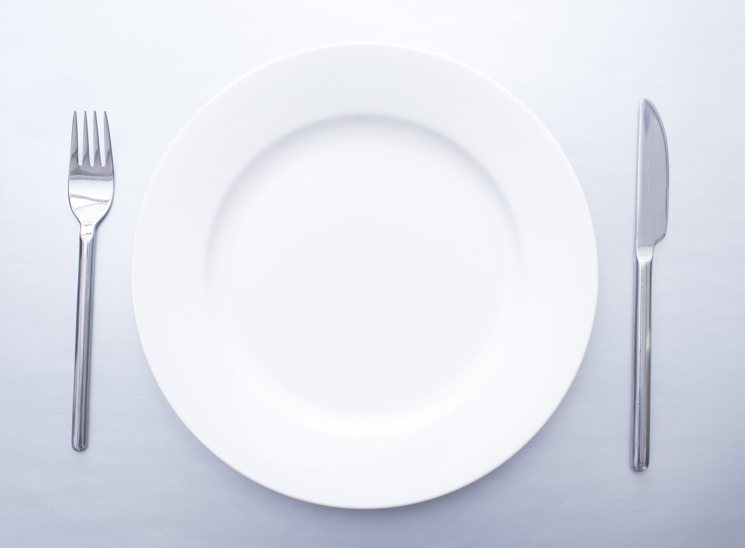
WHEN
YOU
FAST

Slide 2
WHEN
YOU
FAST
INTRODUCTION
Matthew 6:16-18
Matthew 9:14-15

Slide 3
WHEN
YOU
FAST
WHAT IS FASTING?
2nd Corinthians 11:23-31

Slide 4
WHEN
YOU
FAST
WHY SHOULD ANYONE FAST?
To Set Mental Focus
2nd Chronicles 20:1-3
Matthew 4:1-2

Slide 5
WHEN
YOU
FAST
WHY SHOULD ANYONE FAST?
To Intensify Prayer
2nd Samuel 12:15-23
Acts 14:23

Slide 6
WHEN
YOU
FAST
WHY SHOULD ANYONE FAST?
To Mourn
Judges 20:18-26
Esther 3:12-4:3

Slide 7
WHEN
YOU
FAST
WHY SHOULD ANYONE FAST?
For Humility
Isaiah 58:1-3
Psalm 35:13

Slide 8
WHEN
YOU
FAST
WHY SHOULD ANYONE FAST?
Because of Repentance
Acts 9:1-9
Jonah 3:5-10
Daniel 9:1-5; Nehemiah 1:1-11

Slide 9
WHEN
YOU
FAST
HOW SHOULD FASTING BE DONE?
Don’t Draw Attention to Yourself
Matthew 6:16-18
Luke 18:9-14
Zechariah 7:5

Slide 10
WHEN
YOU
FAST
HOW SHOULD FASTING BE DONE?
Refrain from Other Pleasures
Daniel 6:18
1st Corinthians 7:3-5

Slide 11
WHEN
YOU
FAST
HOW SHOULD FASTING BE DONE?
Duration Will Vary
Esther 4:16
1st Samuel 31:11-13; 2nd Samuel 1:12
Daniel 10:2-3

Slide 12
WHEN
YOU
FAST
CONCLUSION
Jeremiah 14:12
Joel 2:12-13

