Slide 1
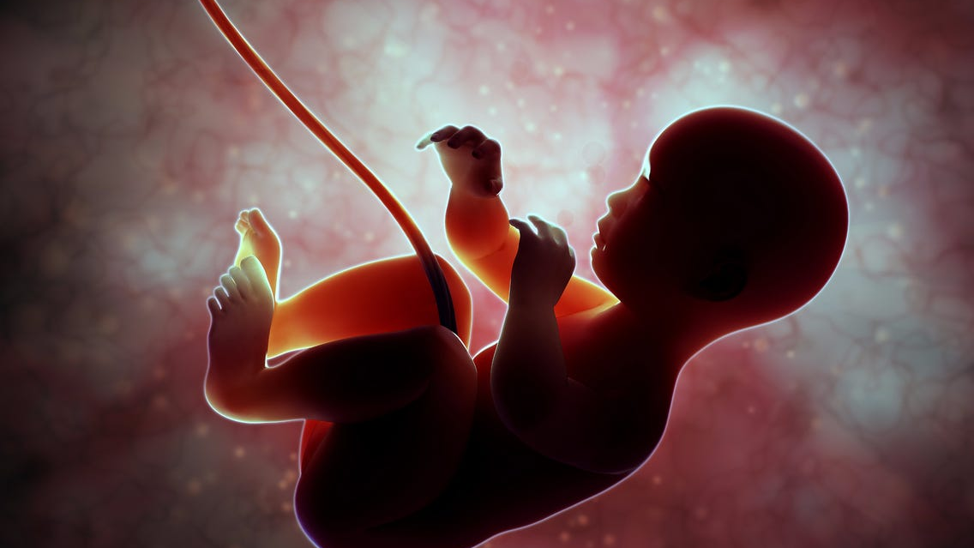
“YOU HAVE SLAIN MY CHILDREN”

Slide 2
“YOU HAVE SLAIN MY CHILDREN”
Introduction
Ezekiel 16:20-21; Psalm 106:35-39
Exodus 21:22-25

Slide 3
“YOU HAVE SLAIN MY CHILDREN”
Sacrificed to the Idol Self
Romans 2:5-9; Philippians 2:3-4
1st Corinthians 6:19-20
Titus 2:4; Romans 1:28-31

Slide 4
“YOU HAVE SLAIN MY CHILDREN”
Sacrificed to the False God Overpopulation
Genesis 1:28; 9:1
Psalm 127:3-5
1st Samuel 1:1-28

Slide 5
“YOU HAVE SLAIN MY CHILDREN”
Sacrificed to the Idol Quality of Life
James 4:14; Matthew 6:34
2nd Corinthians 12:7-10; Romans 5:3-5
Romans 8:18; 2nd Corinthians 4:16-18

Slide 6
“YOU HAVE SLAIN MY CHILDREN”
Sacrificed to the Demon Racism
Romans 2:11
Exodus 1:7-10, 15-16, 22

Slide 7
“YOU HAVE SLAIN MY CHILDREN”
Sacrificed to the Demon Injustice
Deuteronomy 22:25
Proverbs 6:16-19

Slide 8
“YOU HAVE SLAIN MY CHILDREN”
Conclusion
Revelation 21:8
1st Corinthians 6:9-11

