Slide 1
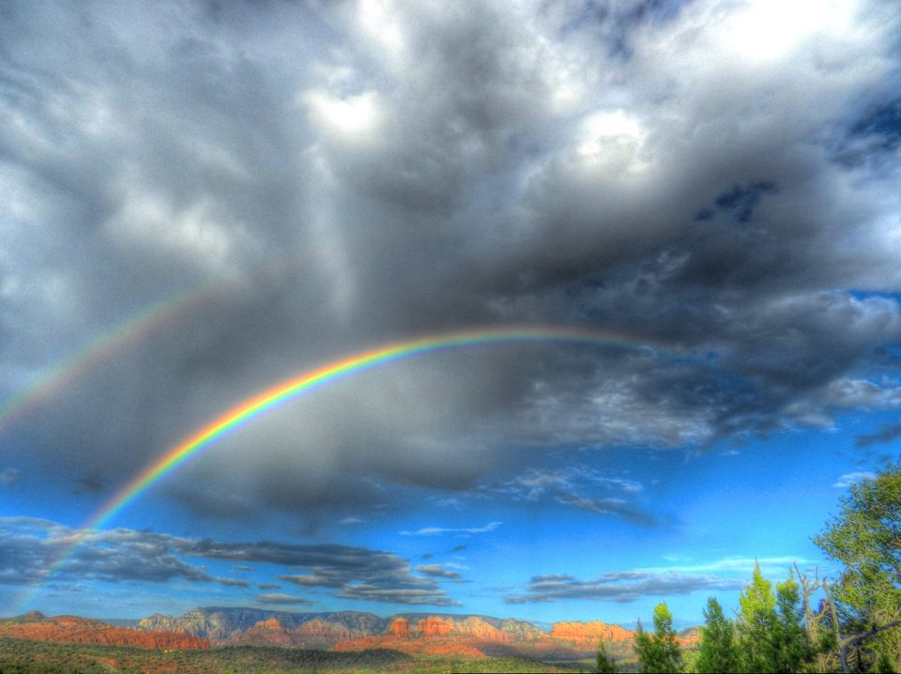
MESSIANIC MILESTONES
the Ascension of the Messiah

Slide 2
the Ascension of the Messiah
Who was present for the Ascension?
Mark 16:14-19
Acts 1:9-11

Slide 3
the Ascension of the Messiah
How did He ascend?
Luke 24:50-51
Acts 1:9

Slide 4
the Ascension of the Messiah
When did He ascend?
Acts 1:1-3
Mark 16:19

Slide 5
the Ascension of the Messiah
Where did He ascend?
Luke 24:50-51
Ephesians 1:15-23

Slide 6
the Ascension of the Messiah
Why did He ascend?
John 16:5-16; Acts 1:4-5, 8
Mark 16:19; Acts 2:33-34
Acts 3:19-26
Acts 5:31
Hebrews 10:11-14
John 14:1-2

Slide 7
the Ascension of the Messiah
What is He doing since ascending?
Acts 7:54-60
Acts 9:1-19
Revelation 1:1
Romans 8:34; Hebrews 4:14-15; 7:25; 9:24

