Slide 1
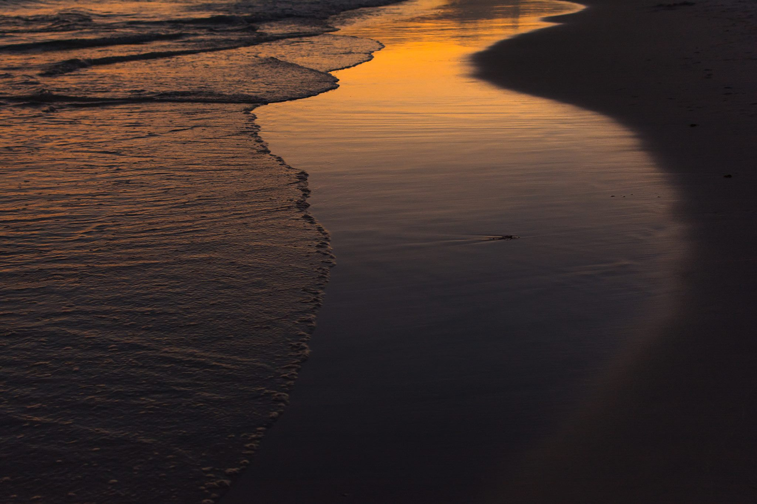
MESSIANIC MILESTONES
The Baptism of the Messiah

Slide 2
THE BAPTISM OF THE MESSIAH
Who Baptized Him?
Mark 1:9
Luke 1:5-25, 57-80
Malachi 3:1; 4:5-6; Matthew 11:7-11
Isaiah 40:3; Matthew 3:1-3

Slide 3
THE BAPTISM OF THE MESSIAH
When was He Baptized?
Mark 1:6-9
Luke 3:21_{a}; Acts 13:23-25
Acts 1:21-22
Luke 3:23

Slide 4
THE BAPTISM OF THE MESSIAH
Where was He Baptized?
Matthew 3:13
John 3:23

Slide 5
THE BAPTISM OF THE MESSIAH
How was He Baptized?
Matthew 3:16_{a}
Acts 8:38-39

Slide 6
THE BAPTISM OF THE MESSIAH
What Accompanied His Baptism?
Luke 3:21-22
1st Thessalonians 5:17
John 1:29-34
Matthew 16:15-17

Slide 7
THE BAPTISM OF THE MESSIAH
Why was He Baptized?
Mark 1:4; 1st Peter 2:22
Matthew 3:13-15 ; Psalm 119:172
Luke 7:30

Slide 8
THE BAPTISM OF THE MESSIAH
Conclusion
John 3:26-31
Acts 18:24-19:5

