Slide 1
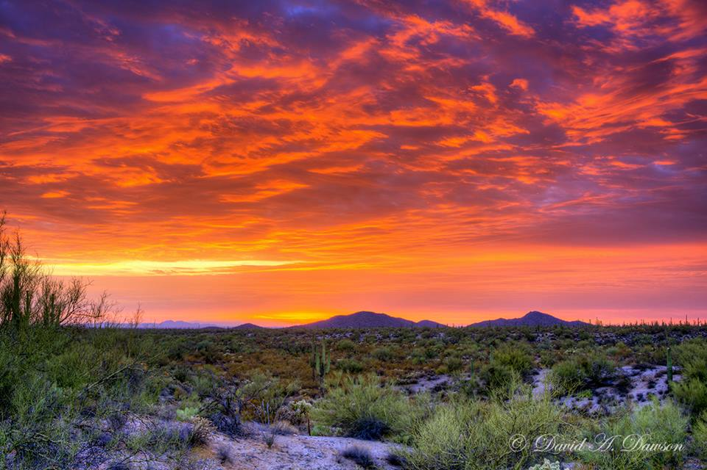
MESSIANIC MILESTONES
The Birth of the Messiah

Slide 2
The Birth of the Messiah
How Was He Born?
Luke 1:26-38
Matthew 1:18-25

Slide 3
The Birth of the Messiah
Who Was at His Birth?
Luke 2:8-20
Matthew 2:1, 9, 11

Slide 4
The Birth of the Messiah
When Was He Born?
Luke 2:1-2; Matthew 2:1
Luke 2:8; Proverbs 30:6

Slide 5
The Birth of the Messiah
Where Was He Born?
Matthew 2:4-6; Micah 5:2; Joshua 19:10, 15
Luke 2:1-7; 2nd Corinthians 8:9

Slide 6
The Birth of the Messiah
Why Was He Born?
Hebrews 2:14-18
Galatians 4:4-5
Luke 2:25-32, 36-38

