Slide 1
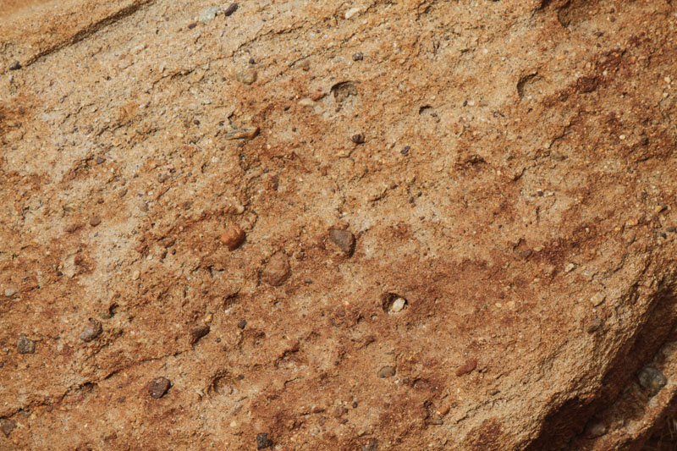
MESSIANIC MILESTONES
the Burial of the Messiah

Slide 2
the Burial of the Messiah
Who buried Him?
John 12:1-7; Mark 14:9
John 19:38-39; Numbers 19:11
Luke 23:50-52; Mark 15:42-43
John 3:1-21; 7:45-52
Matthew 27:61; Mark 16:1

Slide 3
the Burial of the Messiah
When was He buried?
Mark 15:42-45
John 19:31-37, 42; Deuteronomy 21:22-23
Matthew 12:38-41
1st Corinthians 15:3-4; Romans 6:3-6

Slide 4
the Burial of the Messiah
Where was He buried?
John 19:41-42
Matthew 27:57-58; Isaiah 53:9

Slide 5
the Burial of the Messiah
How was He buried?
John 19:40
Matthew 27:60
Matthew 27:62-66

Slide 6
the Burial of the Messiah
What did He do while He was buried?
Luke 23:39-43; 2nd Corinthians 12:2-3; Revelation 2:7
Acts 2:25-32
1st Peter 3:18-21; 4:6

Slide 7
the Burial of the Messiah
Why was He buried?
Ecclesiastes 6:3; 2nd Kings 9:10
Colossians 2:11-13; Romans 6:3-6

