Slide 1
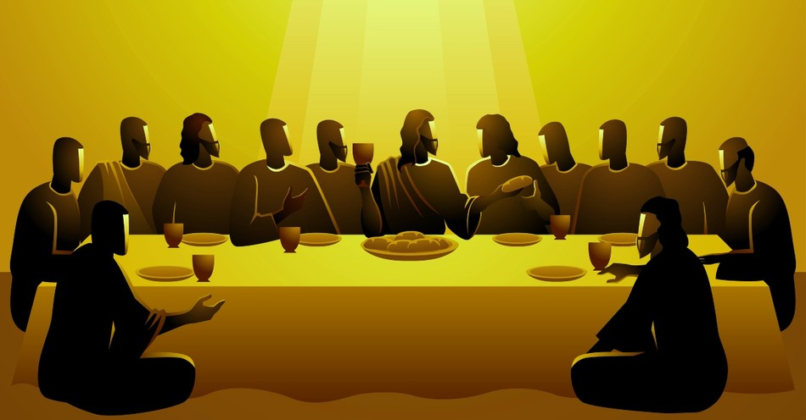
Messianic milestones
The last supper
of the messiah

Slide 2
Introduction
Acts 10:40-41
John 21:4-14

Slide 3
When did He eat?
Luke 22:7-15
Exodus 12:1-20
1st Corinthians 5:7

Slide 4
Where did He eat?
Mark 14:12-16
Mark 11:1-6

Slide 5
Whom did He eat with?
Mark 14:16-18
Exodus 12:3-4
John 13:21-30

Slide 6
Whom did He eat with?
John 13:21-30
Matthew 26:21-24; Revelation 22:11
Psalm 41:9
John 6:64

Slide 7
Whom did He eat with?
Luke 22:31-34
1st Corinthians 10:13
Galatians 6:1

Slide 8
What did He teach?
Matthew 26:26-29
1st Corinthians 11:23-34
1st Corinthians 10:16-17, 21
Acts 2:42; 20:7

Slide 9
Why did He wash feet?
John 13:1-17
Mark 10:35-45
Philippians 2:5-11

