Slide 1
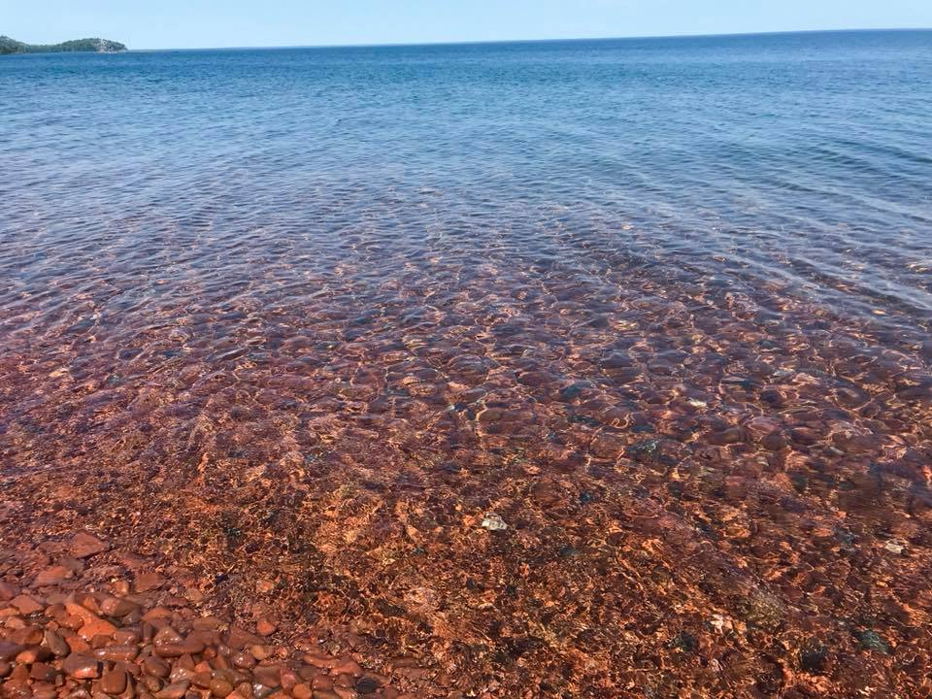
MESSIANIC MILESTONES
The Miracles of the Messiah

Slide 2
The Miracles of the Messiah
What miracles did He perform?
John 9:1-11, 30-33
John 2:1-11
Mark 6:35-44
Matthew 8:23-27
Matthew 14:22-33
John 11:38-44

Slide 3
The Miracles of the Messiah
Who empowered Him to perform miracles?
Luke 11:14-22
Acts 10:38; John 10:38

Slide 4
The Miracles of the Messiah
When did He perform miracles?
John 2:1-11
John 20:19, 26; 21:1-16; Luke 24:31
Luke 4:9-12
Mark 15:29-32

Slide 5
The Miracles of the Messiah
How did He perform miracles?
John 11:41-44; Matthew 8:5-13
Matthew 8:2-3, 14-15
Mark 5:25-34; 6:56
Mark 7:32-35; 8:22-25

Slide 6
The Miracles of the Messiah
Why did He perform miracles?
Mark 2:1-12
Acts 2:22
John 20:30-31

